Slide 1
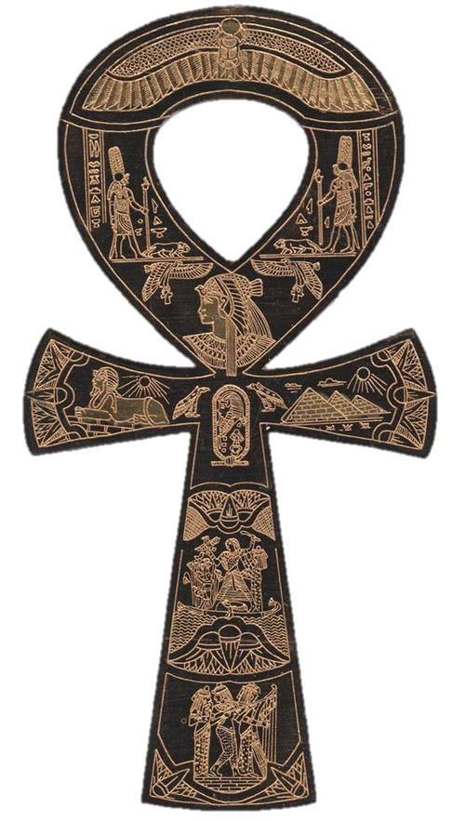
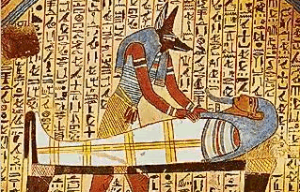
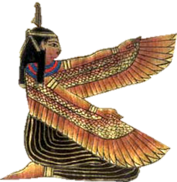
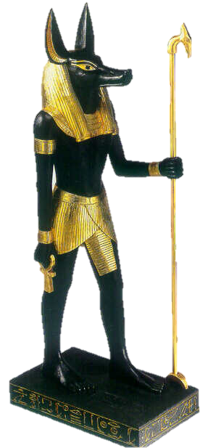
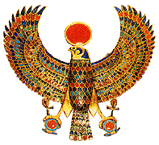
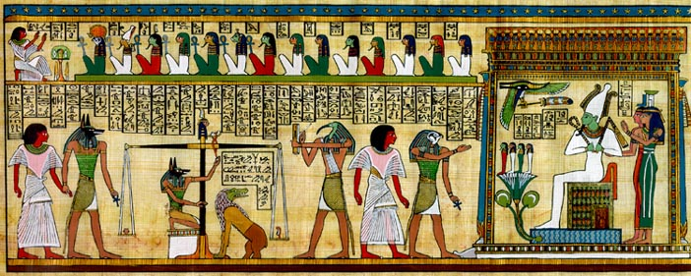
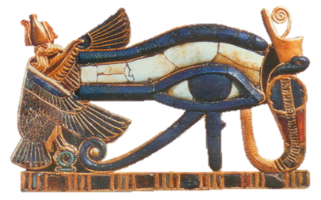
Egyptian Mythology & Spiritual Beliefs

Slide 2
Egyptian Religion
Mac’s History
Polytheistic (many gods) – over 2000 in the Egyptian pantheon
Need and desire to please their gods’ driving forces that influenced most aspects of life
Religion was instrumental to stability of Egypt
Those who lived “good lives” would attain a happy eternity alongside the gods
Egyptian myths and creation stories were varied and often contradicted each other as they evolved over thousands of years in different locations in Egypt

Slide 3
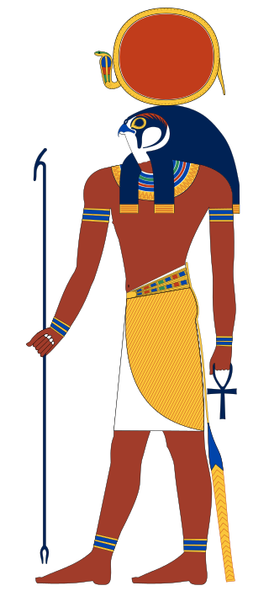
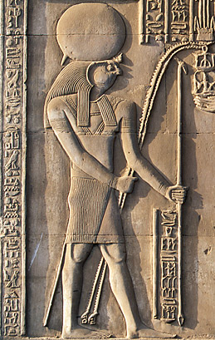
Egyptian Gods
Mac’s History
Ra (Re)
Identified as the sun
His chief cult center was Iunu (Heliopolis)
Head of nine gods known as the Ennead
Created the world
Supreme judge of the dead

Slide 4
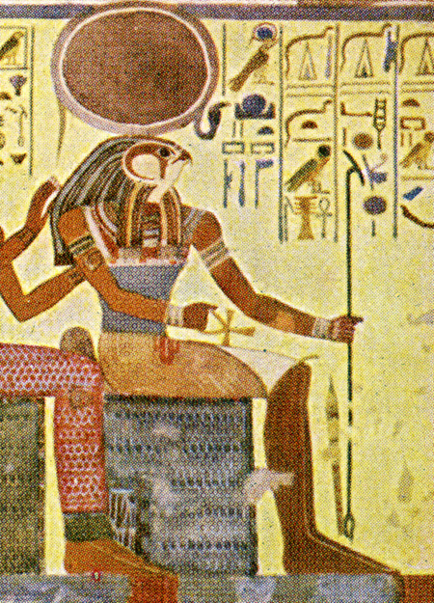
Egyptian Gods
Mac’s History
Ra (Re)
Closely connected to the pharaohs of Egypt who were known as the “son of Ra”
Was combined with other Egyptian gods at various points such as Horus (Ra-Horakhty) and Amun (Amun-Ra)
Was depicted as the sun’s disk, or as a falcon-headed man wearing a sun disc on his head

Slide 5
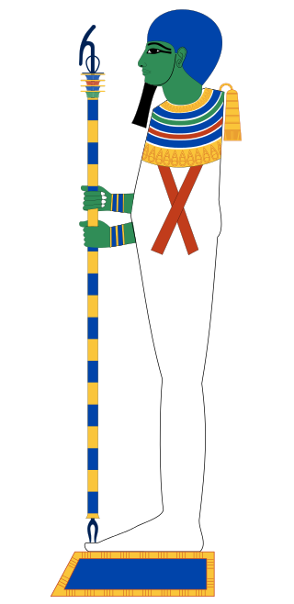
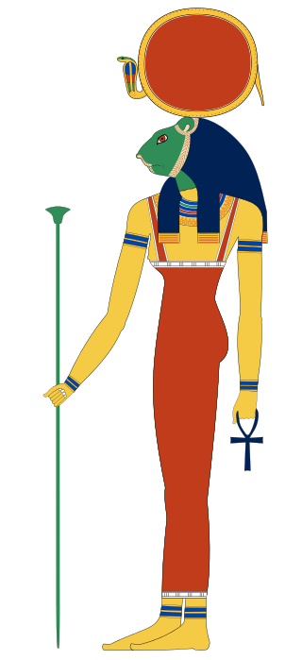
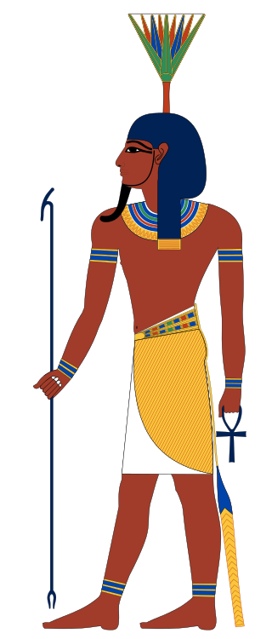
Egyptian Gods
Mac’s History
Ptah
Head of three gods/goddesses worshiped at Memphis
His wife Sekhmet was the lion-headed goddess, his son Nefertem was the lotus god
(Alternate creation story) Creator god – existed before all other things, brought the world into being with his thought and speech
Patron of craftsmen and architects
Depicted in the form of a mummified man

Slide 6
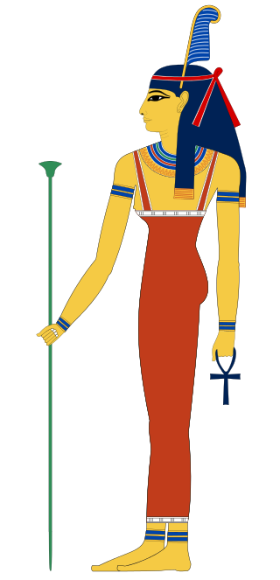
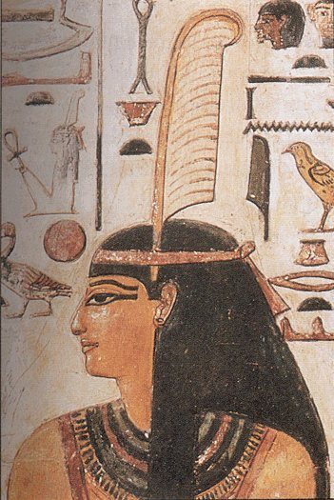
Egyptian Gods
Mac’s History
Ma’at
Was the Ancient Egyptian concept of truth, balance, order, law, morality, and justice
Also personified as a goddess who set the order of the universe from chaos

Slide 7
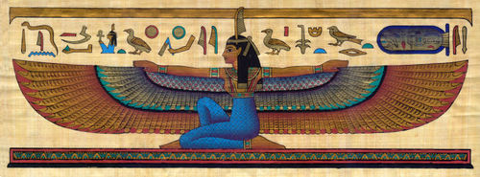
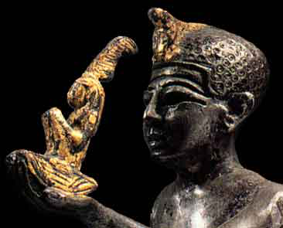
Egyptian Gods
Mac’s History
Ma’at
Responsible for weighing of souls in the underworld
Pharaohs are often depicted with the emblems of Ma’at to emphasize their role in upholding laws of the Creator

Slide 8
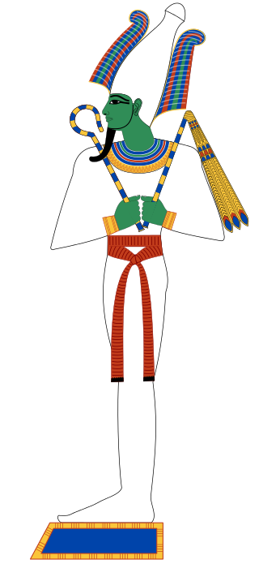
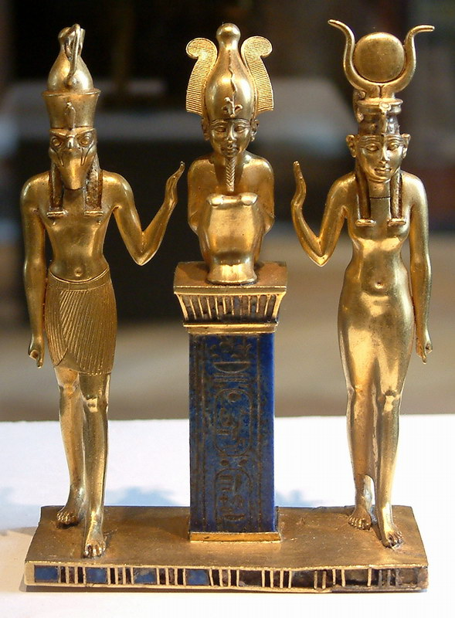
Egyptian Gods
Mac’s History
Osiris
God of the underworld, resurrection, the Inundation (flooding), and vegetation
Chief judge of the Underworld
Was an enlightened king of Egypt, murdered by his brother Seth/Set but was resurrected
Worshiped at Abydos, his chief cult center

Slide 9
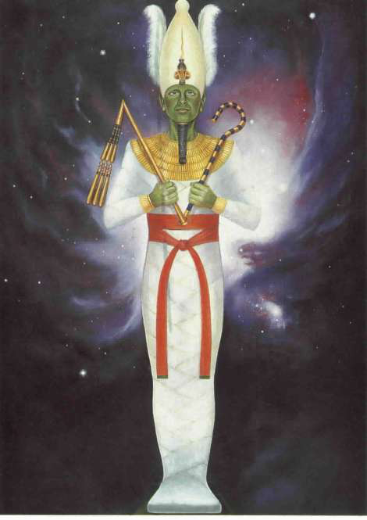
Egyptian Gods
Mac’s History
Osiris
According to the myth of Osiris he was the first to be mummified in Egypt linking mummification with resurrection
Celebrated and revered by the Egyptians for the hope of eternal life
Represented as a mummified king

Slide 10
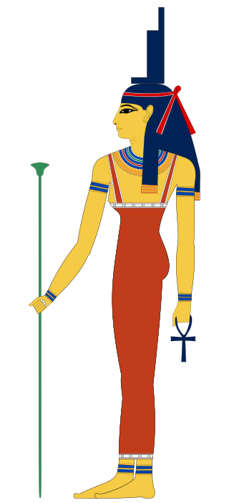
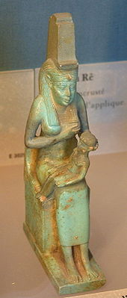
Egyptian Gods
Mac’s History
Isis
Goddess of magic and guardian of the dead
Worshipped as a mother goddess for her devotion to her husband Osiris and her son Horus
Most popular of the Egyptian pantheon – her cult would spread beyond Egypt and throughout the Mediterranean world

Slide 11
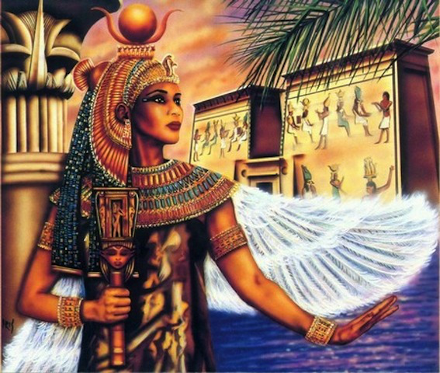
Egyptian Gods
Mac’s History
Isis
Along with her sister Nephthys and the goddesses Neith and Selket, she protected coffins and Canopic jars
Would provide a natural transition for Egyptians to Christianity centuries later as she was equated with the Virgin Mary

Slide 12
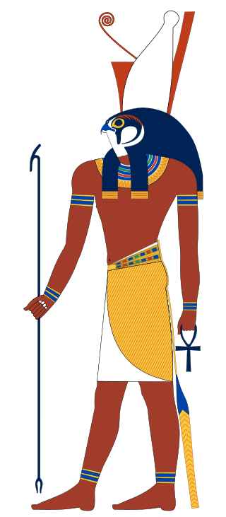
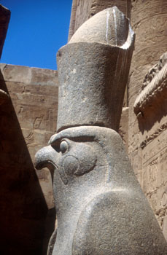
Egyptian Gods
Mac’s History
Horus
Originally the sky-god
Son of Osiris and Isis, born after the death of his father
Raised by his mother to avenge his father’s death

Slide 13
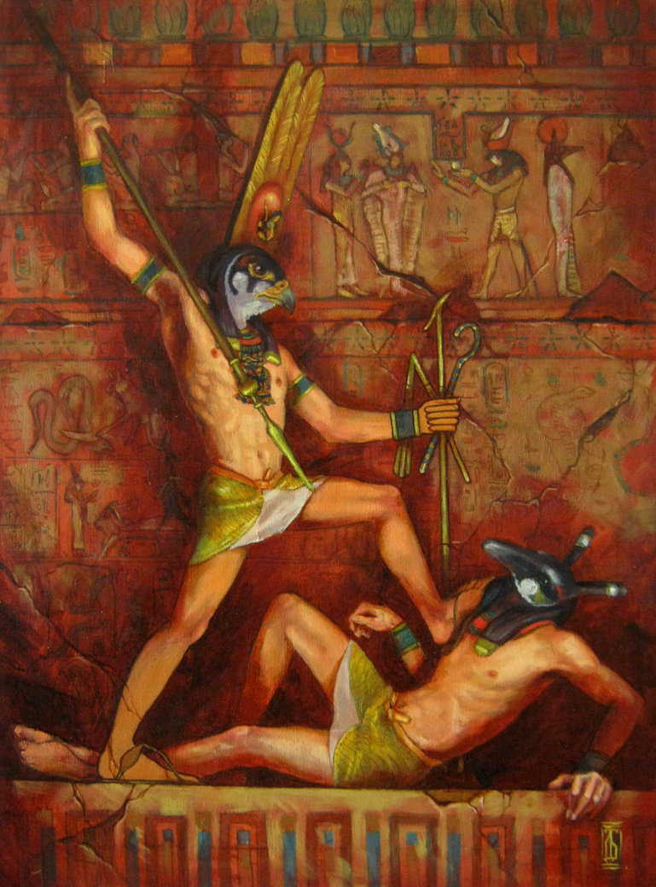
Egyptian Gods
Mac’s History
Horus
Fought with Seth for 80 years before the gods awarded him victory and the throne of Egypt
Had cult centers at Behdet, Hierakonpolis, and Edfu
Depicted as a falcon or a falcon-headed man

Slide 14
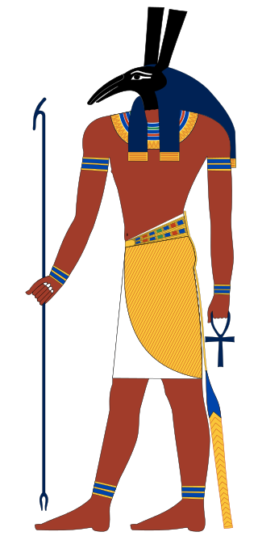
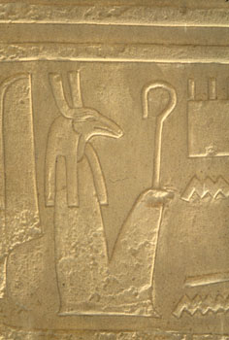
Egyptian Gods
Mac’s History
Seth/Set
The Red God, god of the desert, thunderstorms, and violence
Brother and murderer of Osiris and rival of Horus
One of Egypt’s oldest deities – Egyptians feared him for his ability to do harm and admired him for his strength and ferocity

Slide 15
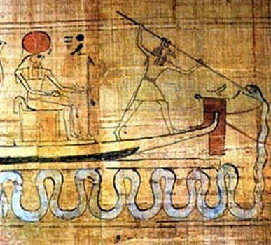
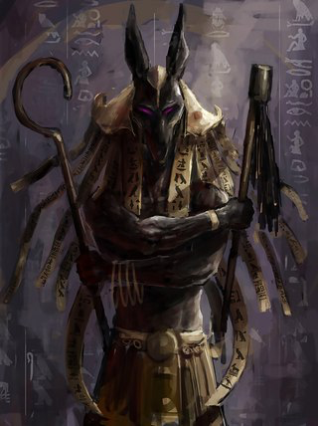
Egyptian Gods
Mac’s History
Seth/Set
Portrayed as the protector of Ra, standing on the prow of Ra’s boat defeating the serpent Apep
When the Hyksos invaded and conquered Egypt they chose Set as their god
Represented as an animal that has yet to be identified by Egyptologists

Slide 16
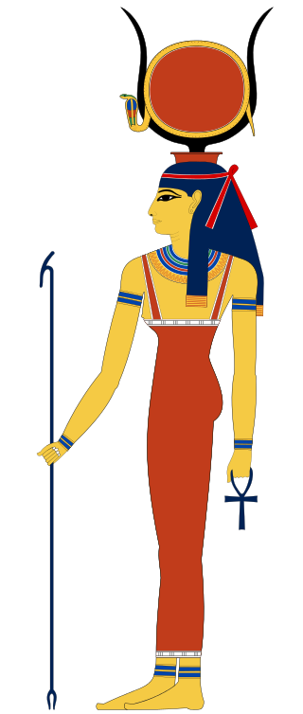
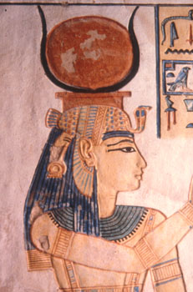
Egyptian Gods
Mac’s History
Hathor
Wife of Horus
The Golden One, Lady of Love, Music, and Intoxication
Her cult center was at Dendera
Symbol of motherhood and fertility, patron-goddess of unmarried women
Notes:
Egyptians saw the Milky Way as the milk flowing from the udders of a heavenly cow

Slide 17
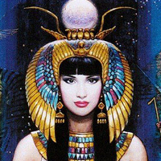
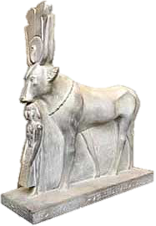
Egyptian Gods
Mac’s History
Hathor
Depicted as a cow, cow-headed woman, or a woman with cow’s horns and ears
Sometimes seen as the personification of the Milky Way
Notes:
Egyptians saw the Milky Way as the milk flowing from the udders of a heavenly cow

Slide 18
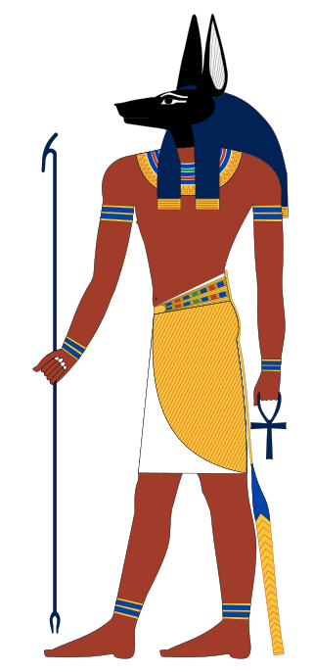
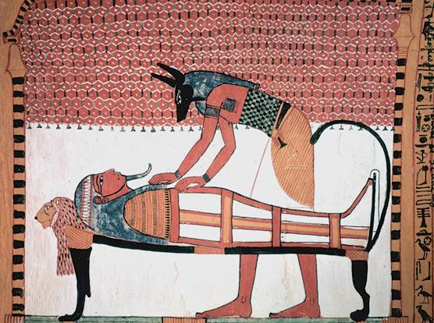
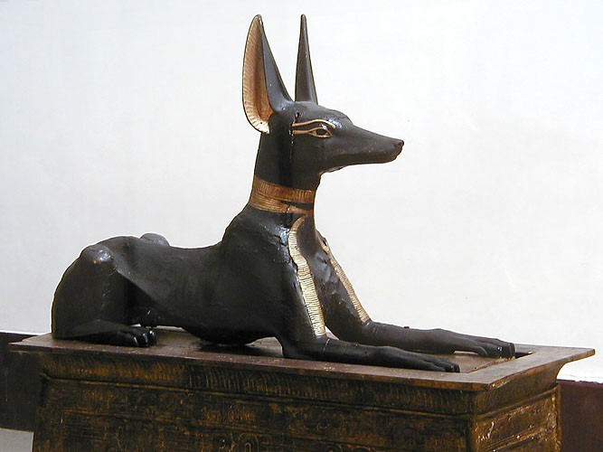
Egyptian Gods
Mac’s History
Anubis
Was the great funerary god before Osiris rose to prominence
Prayers for the dead were addressed to him
He carried out the first mummification on the body of Osiris

Slide 19
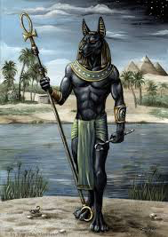
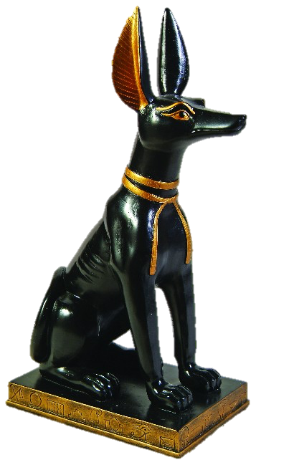
Egyptian Gods
Mac’s History
Anubis
Patron-god of embalmers
Guided the dead on the paths of the Underworld
Depicted as a black jackal-like creature, or as a man with a jackal’s head

Slide 20
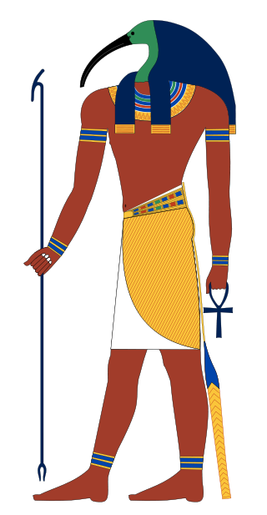
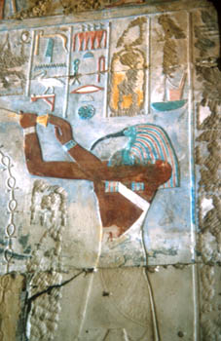
Egyptian Gods
Mac’s History
Thoth
Was the moon god
Inventor of writing and scribe to the gods
Recorded the verdict on the dead as they were judged
Had in his possession a book with all of the world’s wisdom
His chief place of worship was Hermopolis Magna
Depicted as an ibis-headed man

Slide 21
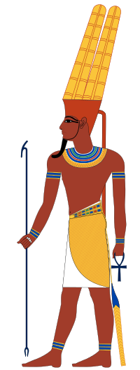
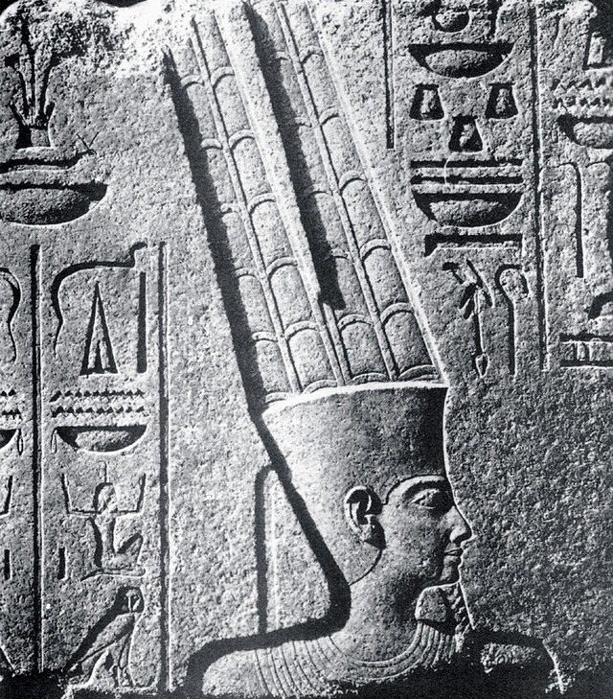
Egyptian Gods
Mac’s History
Amun
Means the invisible one
Was the patron deity of Thebes
When Thebes led the rebellion against the invading Hyksos Amun quickly rose in importance
He became associated with Ra and Amun-Ra became the most important god in Egypt

Slide 22
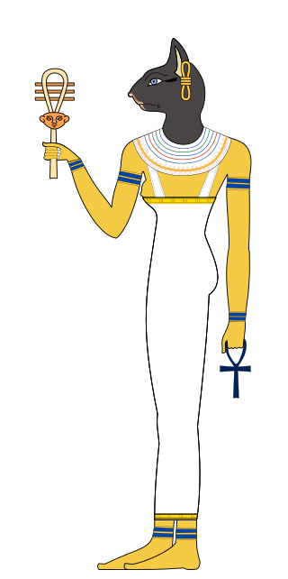
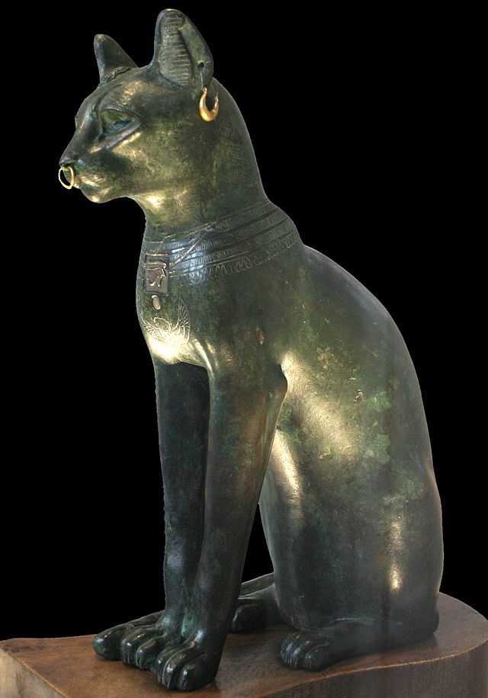
Egyptian Gods
Mac’s History
Bastet
Goddess of sexuality and fertility
Daughter of Ra
Also thought of as the virgin goddess though she had a son
Depicted as a domestic cat or a cat-headed woman
Cats were revered, praised for chasing away vermin
Cats were often mummified in honor of the goddess

Slide 23
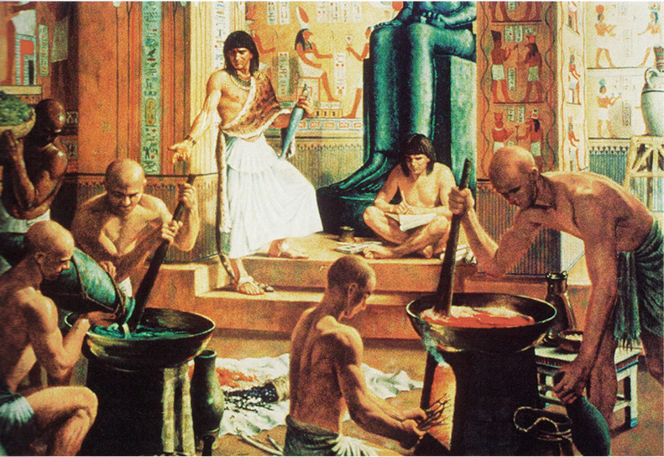
Egyptian Priests
Mac’s History
The role of the priest was crucially important in Egyptian society
Egyptians believed the gods lived in their temples
Only the priest could enter the sacred area of the temple and approach the statue representing the god or goddess
Video 1

Slide 24
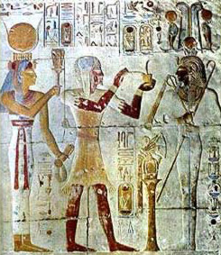
Egyptian Priests
Mac’s History
Priests’ role was to care for the needs of the god/goddess – they had no role to oversee or care for the people of Egypt
The pharaoh would often choose the new priests and they were often family members for the most important temples

Slide 25
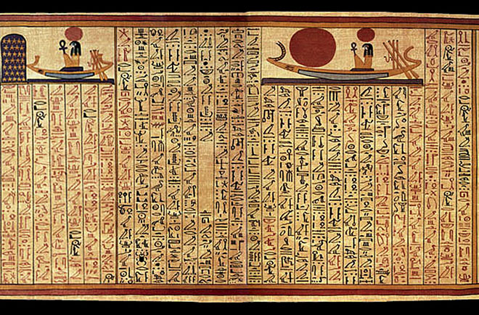
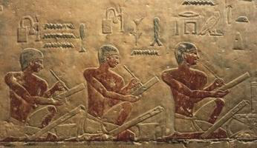
Book of the Dead
Mac’s History
The Book of the Dead was an ancient Egyptian funerary text used during the New Kingdom
Written on papyrus it consists of several magic spells intended to assist a dead person’s journey to the afterlife
Written by many priests over a period of 1000 years

Slide 26
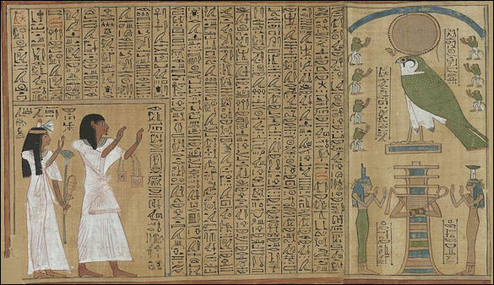
Book of the Dead
Mac’s History
Most commonly written in hieroglyphic or hieratic script and often illustrated
There is no one canonical version and many existed in Ancient Egypt

Slide 27
Book of the Dead
Mac’s History

Slide 28
The Afterlife
Mac’s History
Egyptians’ concept of the afterlife reflected their zeal for life and their optimism
They believed the afterlife was a duplication of their best moments on earth
It was expected that in the afterlife they would do all the things they had loved most in life – i.e. fishing, hunting, feasting, and sailing
Egyptians Hunting in the Afterlife

Slide 29
The Afterlife
Mac’s History
An Egyptian’s life and their death would be measured in accordance with the principle of Ma’at
Any Egyptian, regardless of social class, could reach the afterlife but there were two basic requirements:
Their body was preserved in a lifelike form
They had the items needed for the afterlife
These items and personal effects would be placed in the tomb to assist in the journey to the afterlife
The possessions would be quite different depending on if the individual was a peasant or a noble – Video 2

Slide 30
Mac’s History
The Deceased
Judgment of the dead according to the Ancient Egyptians
A panel of 14 judges took account of the deeds in life of the deceased
Anubis would weigh the heart against the feather of Ma’at
If the heart is heavy, it is full of sin and will be devoured by Ammit (crocodile head)
Thoth then makes a record of the outcome
The deceased is then brought before Osiris by Horus for final judgment

Slide 31
Mummification
Mac’s History
Unclear when first begun but by the New Kingdom it had been perfected
Focused on Egyptian belief of the importance of preserving the body for the afterlife
The afterlife was a paradise for Egyptians who earned the right to get there
Body covered with natron and dried for up to 70 days then wrapped in linen and coated with resins and oils
The funerary mask first appeared during the Middle Kingdom

Slide 32
Mummification
Mac’s History
The lungs, stomach, intestines, and liver were removed and placed in canopic jars
The jars were closed with stoppers in the shape of four heads specific to each organ: jackal, human, baboon, and falcon, the four protective spirits called the four sons of Horus
The brain was believed to be worthless and discarded after being drawn out through the nasal cavity

Slide 33
Impact of Religion on Egyptian Society
Mac’s History
Most classes enjoyed the fruit of their labor and respected the many gifts of the Nile provided by the gods
Males and females had equal authority in the home and disrespecting either parent could result in infanticide…kids accused of killing parents in retaliation were immediately killed without trial

Slide 34
Impact of Religion on Egyptian Society
Mac’s History
Women had legal rights and were not recognized as property
Women did not have to be connected to a temple in any way to own and manage property

Slide 35
Impact of Religion on Egyptian Society
Mac’s History
Egyptians saw their gods as helpful providers
the Nile was stable, and flooding was predictable
the soil was nutrient rich and easy to work
the people did not believe their existence to be enslavement or punishment
Video 3

