Slide 1
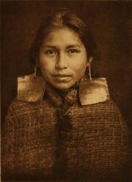
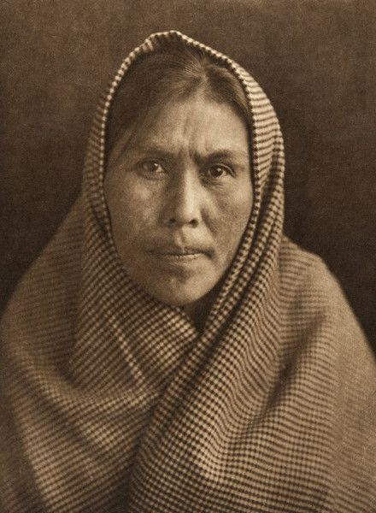
Women, Fur Trade, and a Changing Way of Life

Slide 2
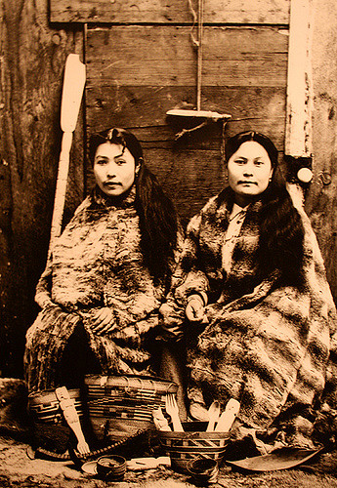
Women in the Fur Trade
Women are often overlooked in the fur trade as men usually took the lead in both trapping and trading.
Women, however, were key to providing for their families while the men were away for long periods of times looking for furs.
Women often prepared the furs and also cleaned and dried the salmon for preservation.

Slide 3
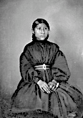
Women & Fort Life
Women had their most significant role in the fur trade and in the future population of BC by marrying employees of the European fur trade.
First Nations women frequently married company employees and they and their children would stay and live in the fort, thus becoming part of a new social, economic, and political relationship.
In some cases, especially on the structured societies on the coast, these marriages were considered to be alliances between high ranking families and the officers of the trading post. This formed an intense bond.

Slide 4
Quality of Relationships
Most marriages worked on a more personal level as Aboriginal women offered companionship for the employees. They also offered an environment of family.
The women also performed the domestic duties.
Women were not considered equals in European societies and First Nations women would have to operate within this social structure.
The FN women also suffered from racial discrimination.
Some women had happy loving marriages where both sides shared in traditional culture and interacted with both families.
Women would give up a great deal in the process of marrying European. In some cases they would break down the racial barriers that existed between the two groups.
For some men, however, these relationships were simply for convenience and would often be abandoned when they were to return to Europe. (pg 73 in text-Connoly v. Woolrich)

Slide 5
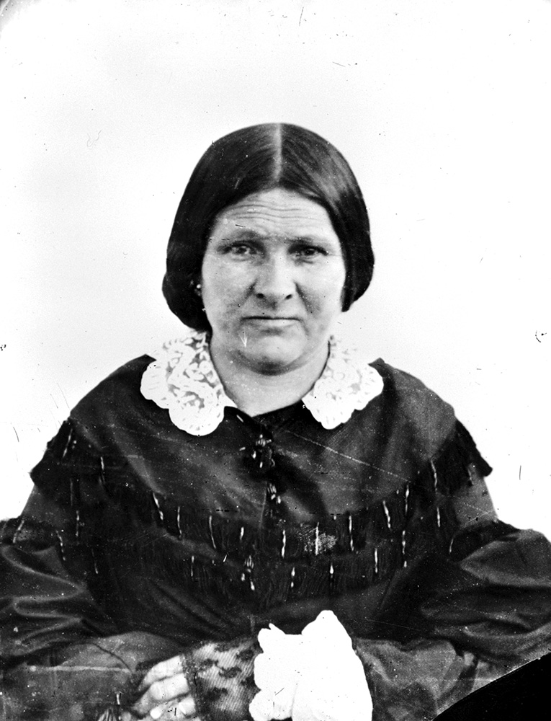
Amelia Douglas
One of William and Suzanne Connolly’s children was to rise to the highest ranks of BC’s colonial society.
Amelia Connolly would marry James Douglas while they were posted at Fort St. James and would become Lady Douglas when James was made governor of the colony of Vancouver Island.
She understood Aboriginal customs and advised her husband in governing over both the European and Aboriginal peoples.
This is an example of an Aboriginal woman bridging the gap between races.

Slide 6
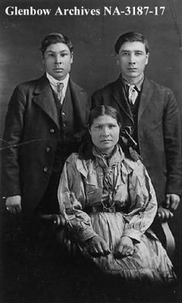
Mixed Ethnicities
On the Prairies, the children of Aboriginal women and the fur trade employees shared many customs, and a distinctive Metis culture with its own language and culture emerged.
In BC this singular culture did not develop and many children of mixed marriages returned to their Aboriginal families, especially prior to the growth of settlements in the province.
Some adopted to their Euro-Canadian culture and assimilated into mainstream culture.
Others found themselves stuck between two worlds, never accepted into either group.
These children were frequently called “half-breeds” which in BC had a very negative connotation.
Within the status system, they would be deemed “non-status” and had no rights under the Indian Act.

Slide 7
Impacts of the Fur Trade
The fur trade changed how much time and effort was put into seasonal activities.
Men spent more time hunting and trapping to supply the fur trade while women worked preparing skins and were much busier than they were before.
These trade oriented activities replaced traditional food harvesting and preparation and created a dependency on European supplies.
Traditional settlement patterns also changed. As the fur trade pushed westward in the early 1700’s, some Aboriginal groups such as the Cree followed the trade. This displaced other groups native to the area.
Armed with new guns gained through trade, groups such as the Cree pushed into the hunting territories of the Dunne-za people over Northern Alberta. The Dunne-za then moved west of the Peace River, effectively displacing the Sekani who had to move into the Rocky Mountains.
With the furs being scarce, this same expanding of territory, or moving of traditional territory occurred in order to access more beaver and other pelts. Sometimes these moves were led by European traders from the Forts.

Slide 8
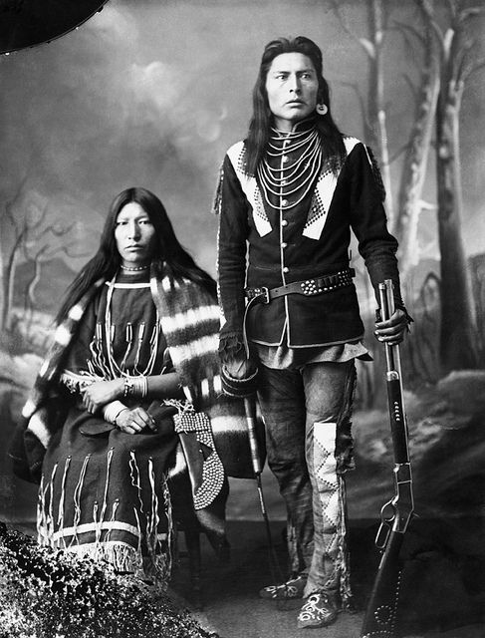
Impacts Continued…
The new trade items also changed FNs way of life.
Some objects made life easier, such as a factory made woolen blanket requiring no lengthily weaving time.
Iron tools increased a carvers output and increased the status of the user.
Guns meant huge status and power and made hunting easier, though many still used their bow and arrow as they found them more reliable.
Guns however changed warfare altogether and could shift the balance of power if one nation had them and another did not.
By trading with Europeans, coastal chiefs increased their wealth and power hugely.
Many groups traditional social patterns were enhanced by the new objects they obtained: MUTUALLY BENEFICIAL

