Slide 1
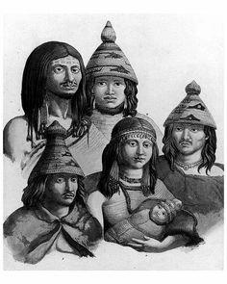
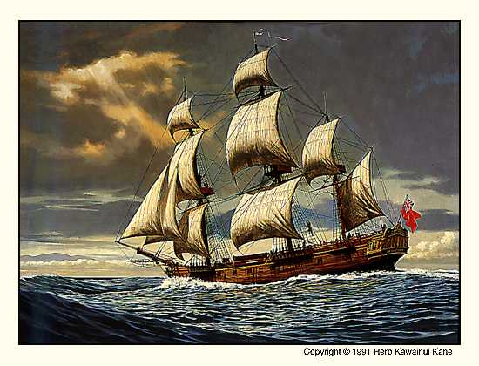
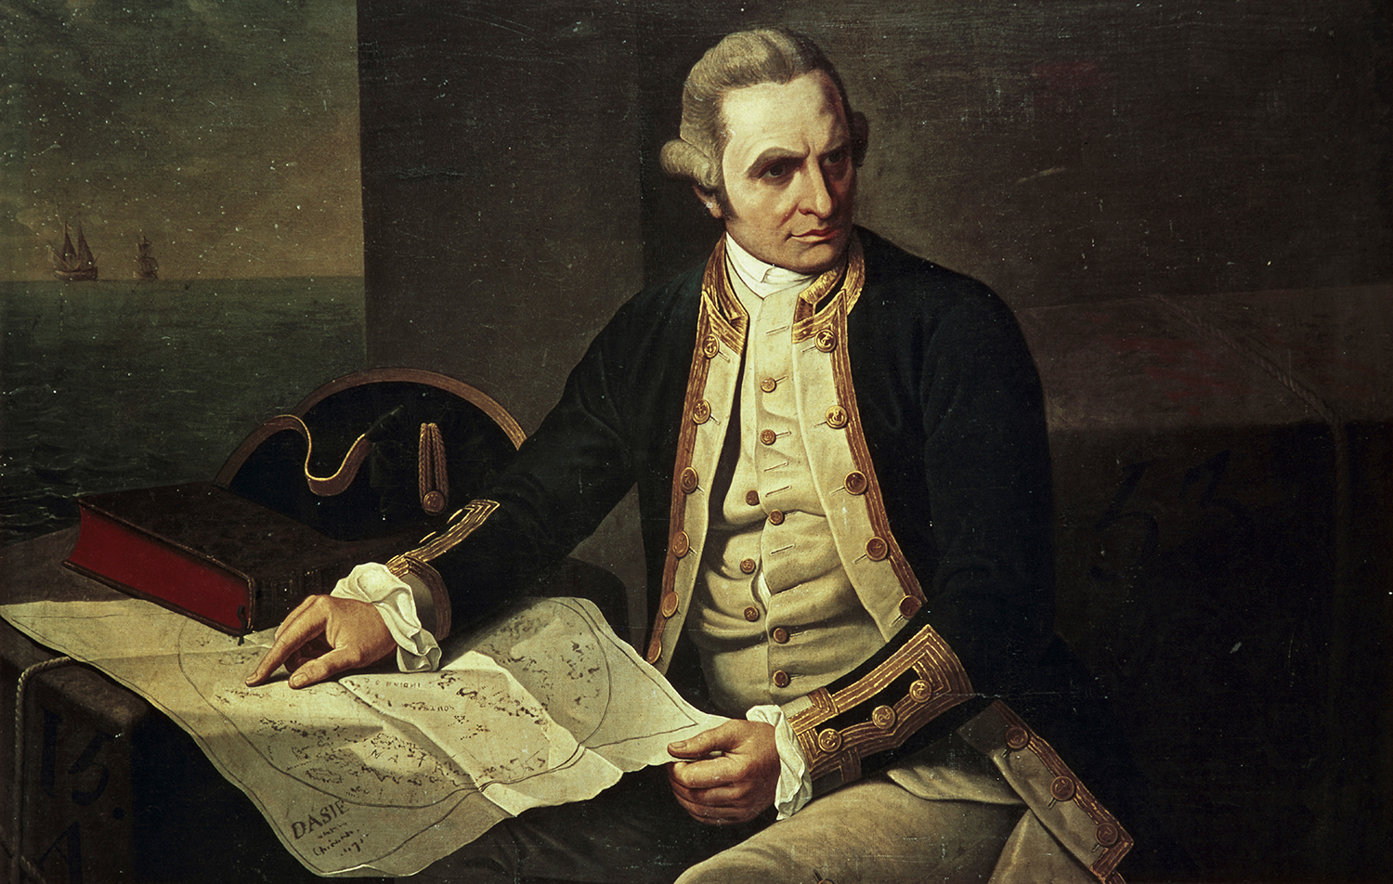
CONTACT IS MADE
First Nations of BC Come into Contact with the Europeans

Slide 2
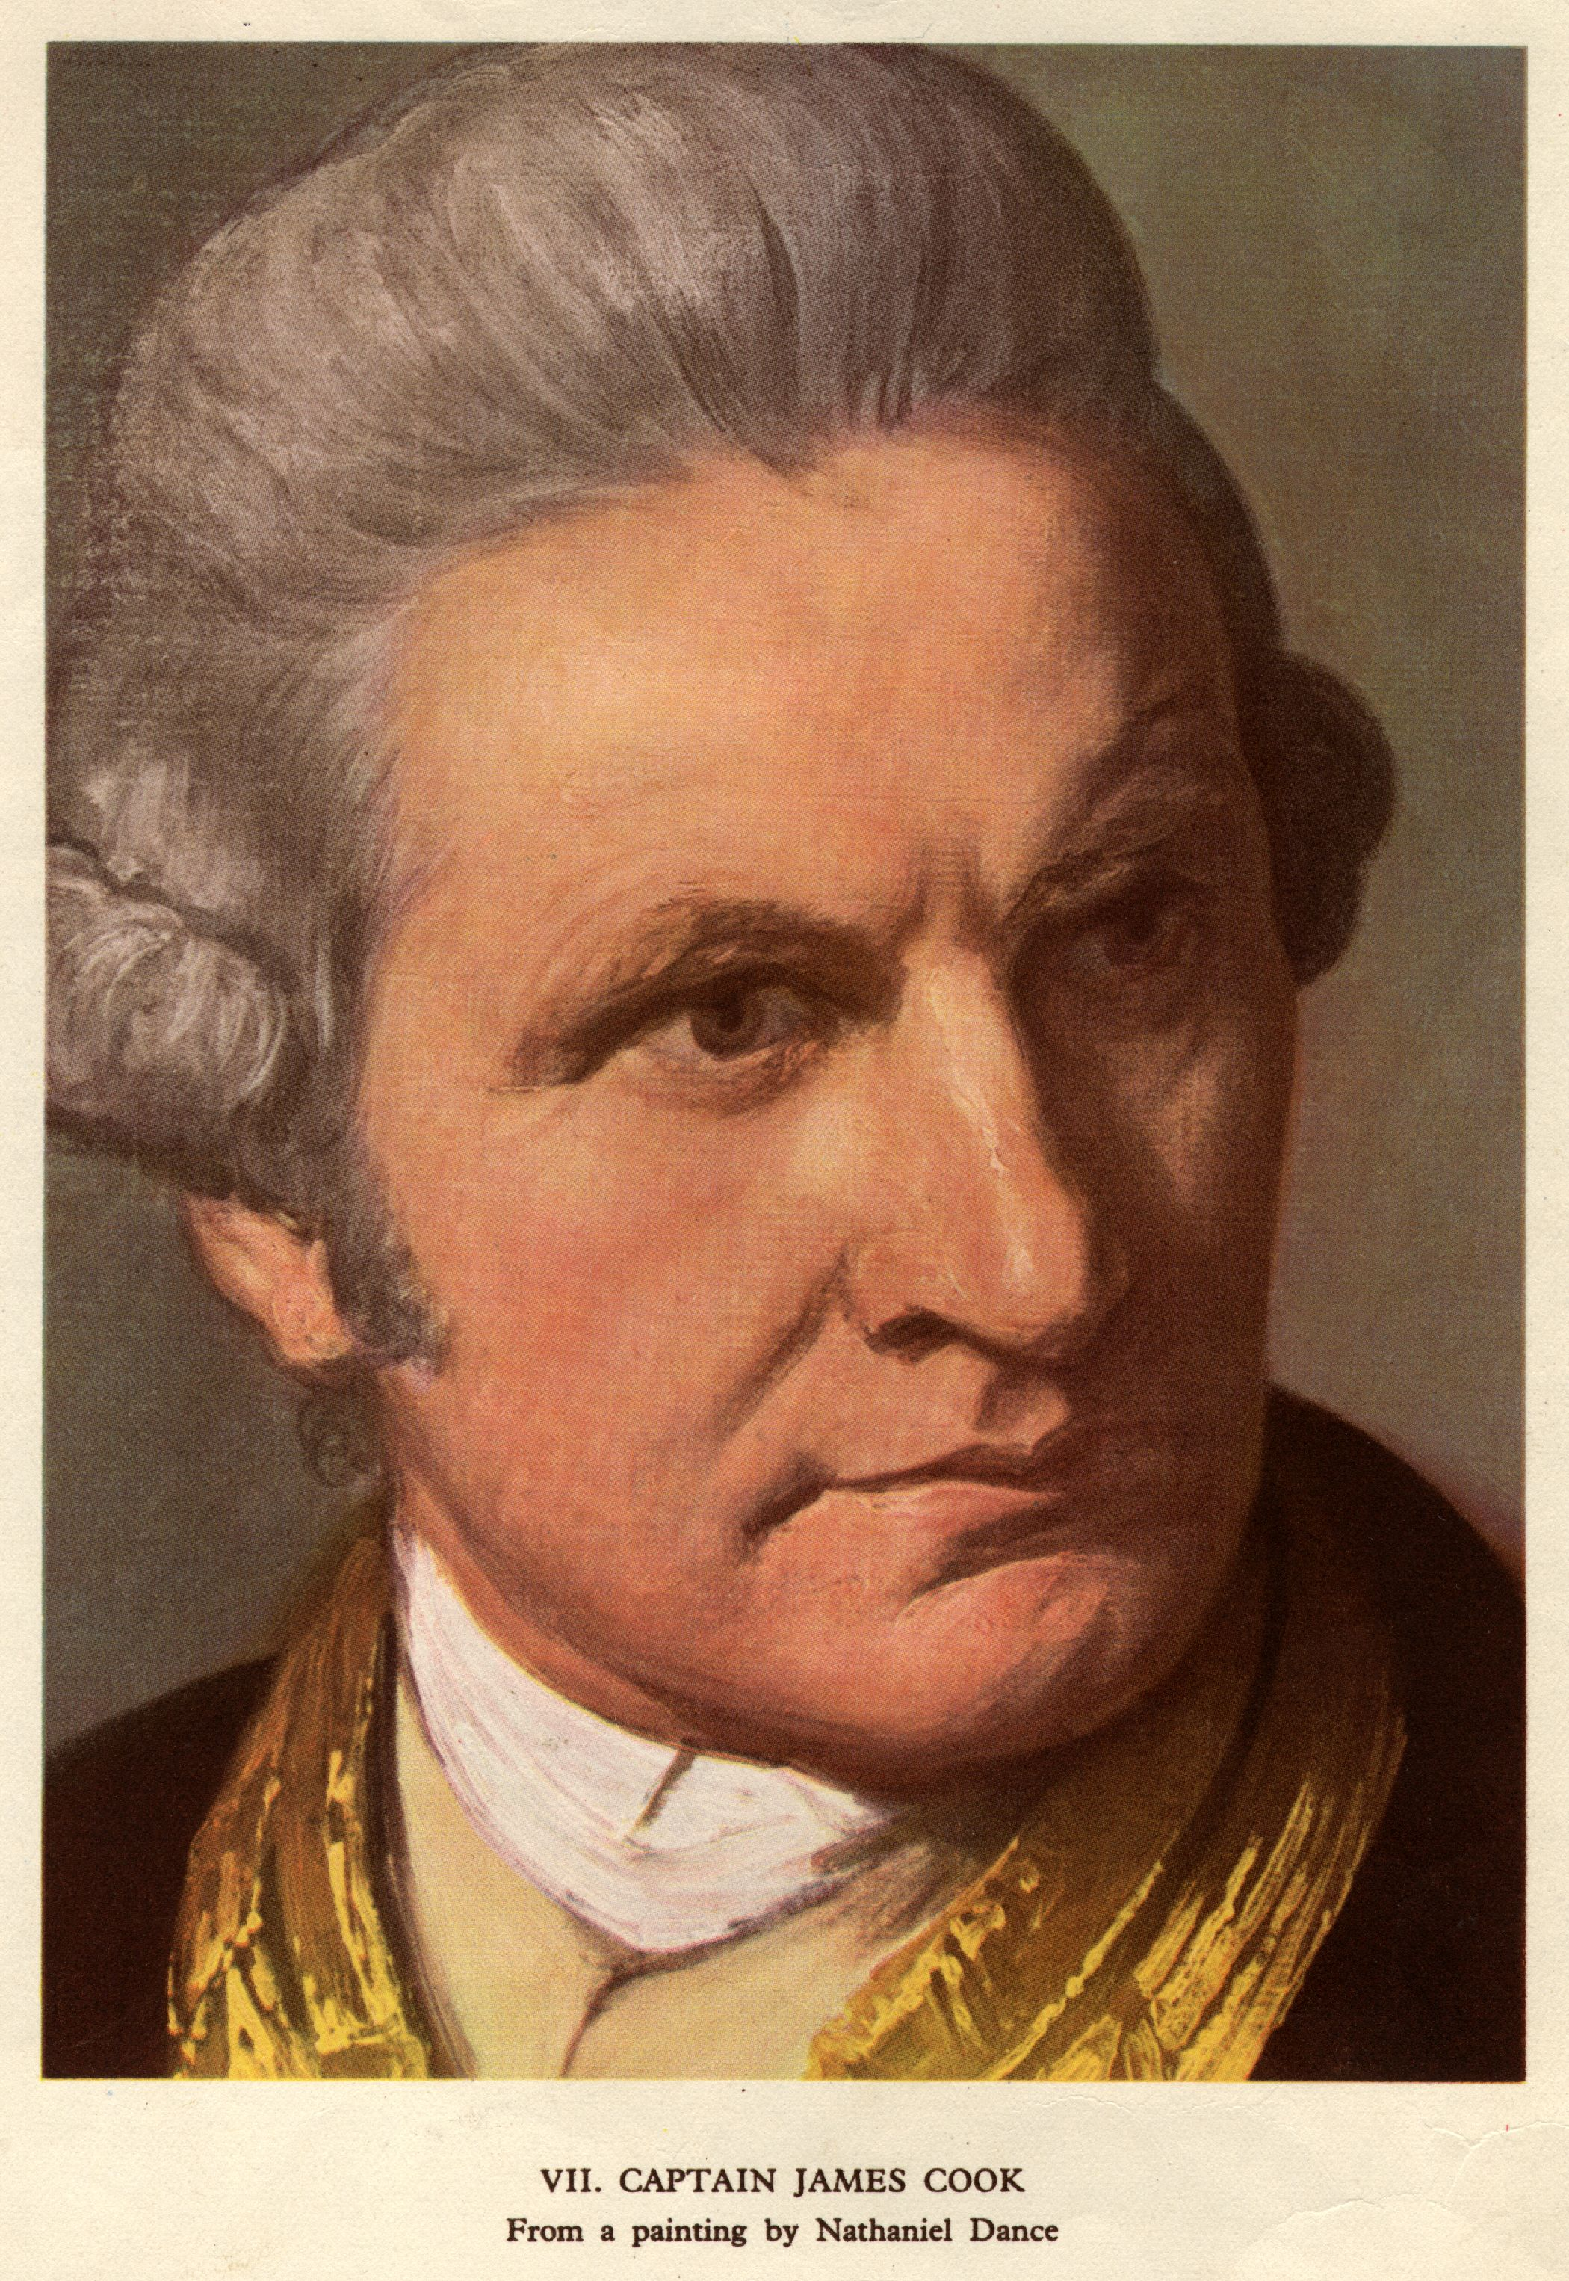
The Arrival of Europeans
First Nations peoples lives were changed forever the first time that the Europeans visited their shores.
Captain Cook was a British explorer who brought on the era of the fur trade when he began exploring what is now BC.
The men came in search of lucrative pelts by ship on the Pacific Ocean. They wanted sea otter.
When Europeans arrived a trade arose in pelts which would soon boom and create a vast immigration of men to take part in this money-making economy.

Slide 3
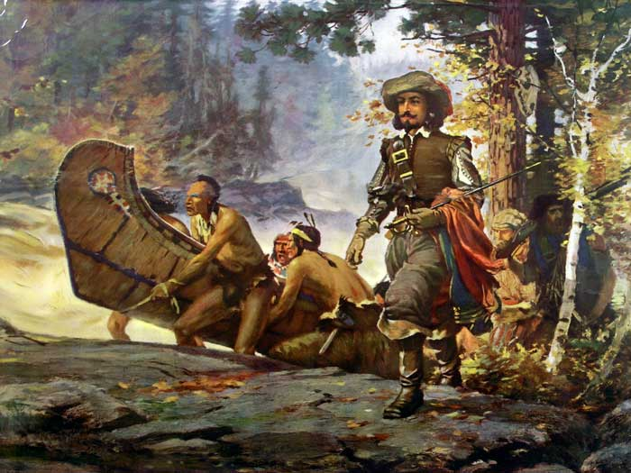
Guides and Teachers
The First Nations peoples then entered into an era of huge trade and interaction with Europeans. This era can be known as the “mutually beneficial” era.
When the business of trade was the main concern of both parties, the First Nations peoples were depended on for services such as guiding, carrying mail, and supplying much of the food that the newcomers needed for daily survival.
The First Nations in turn changed their way of living to incorporate the new technologies they had access to from the Europeans; such as iron to replace stone axes, guns to replace the bow and arrow etc.
The only issue would arise when these same Europeans would bring widespread disease that would all but wipe out the First Nations of BC.

Slide 4
The Last Untouched Wilderness
The last area of Canada to be contacted was B.C.
Contact had been made previously in Canada by countries like Spain, Portugal, England, and France whom had colonies eastern North America, and most of south and central America.
Spain and England were in furious pursuit of what was called the “Northwest Passage.” This was the goal of finding a shortcut through or around North America.
British parliament offered a reward of 20,000 pounds to the first ship that could find the Northwest Passage.

Slide 5
Rivalry
The Spanish and the English developed a fierce rivalry over who could find this passage and who could conquer North America and expand their empire.
This rivalry severely intensified in the 1770’s when the Spanish and English learned that the Russians had begun to colonize the Aleutian Islands in northwest Alaska. They were moving their influence southwards down the coast.
The first recorded contact with BC First Nations people ever was actually a Spanish spy mission led by Juan Perez to see what the Russians were doing.
Juan Perez anchored his ship the Santiago off the northwestern tip of Haida Gwaii. The Haida paddled in their canoes to meet the ship and were willing to take part in trade.
The Nuu-chah-nulth were also encountered at the west of Vancouver island where Perez noted they had copper. The First Nations, though not contacted yet by Europeans, had received European goods through trade with other nations.

Slide 6
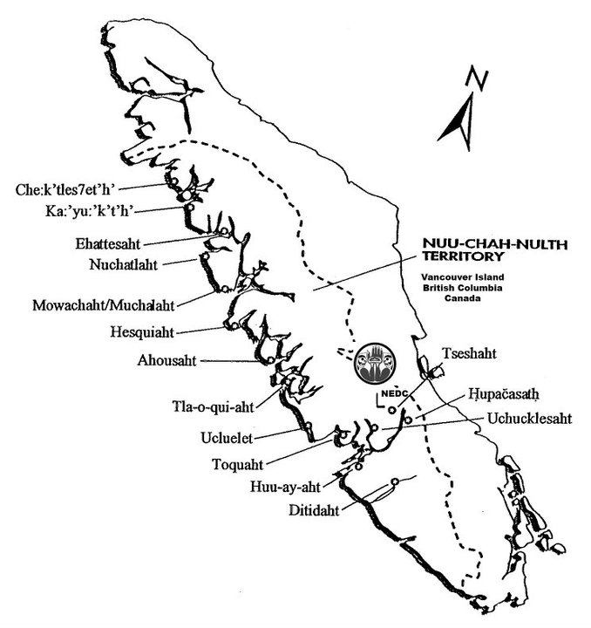
Claim any Empty Land
The west coast of Vancouver Island would be visited again but this time by Captain James Cook, a commander in the British Royal Navy.
Cook was seeking the Northwest Passage and was instructed to claim any territories that looked to be uninhabited in the name of King George III.
He was secretly instructed to not interfere with any Aboriginal territories or territories that had already been taken by other empires, however anything that looked empty he was to claim.
This area was called Yuquot and was Nuu-chah-nulth territory.

Slide 7
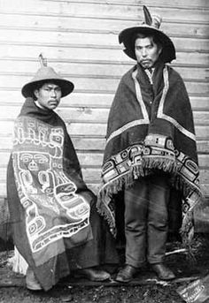
The Nootka Emerge
Cook’s ship named the Resolution and Discovery left for Vancouver Island on March 29, 1778. The English spent a month among the Nu-chah-nulth where they had their ships repaired and where they rested while they traded.
The records of Cook and his men are the first written records of the material culture and social life of the coastal First Nations.
Cook heard the Nuu-chah-nulth say the word nutka which means “go around” and assumed they were saying the name of their group.
The Nuu-chah-nulth were actually telling them to go around and find safe anchorage around a point of land.
They were known as the Nootka ever since and have only recently reclaimed their true name.

Slide 8
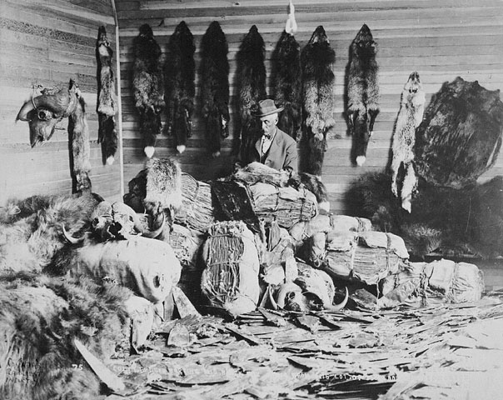
The Race for Furs is On
When the English left they took 1500 sea otter pelts with them.
They also took a tree that had been used to make a mast for their ship.
Cook never returned to England and died in Hawaii soon after leaving the Northwest Coast..
However, he did report on the huge profit to be made selling the fantastic pelts to areas like China.
When word of the fortune to be found in the area broke out, the race for furs and the race to come to the coast began.

Slide 9
5-10 Sentence Response
How did explorers claim land? Why did they think it could be claimed? How did First Nations people view land ownership? How was this era “mutually beneficial?”

