Slide 1
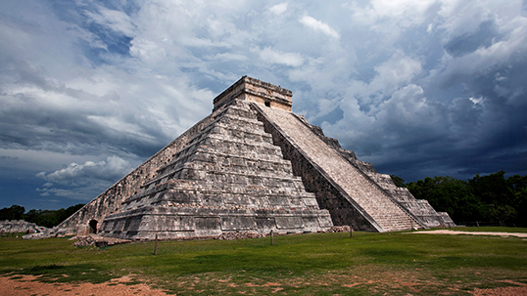
Characteristics of Civilization

Slide 2
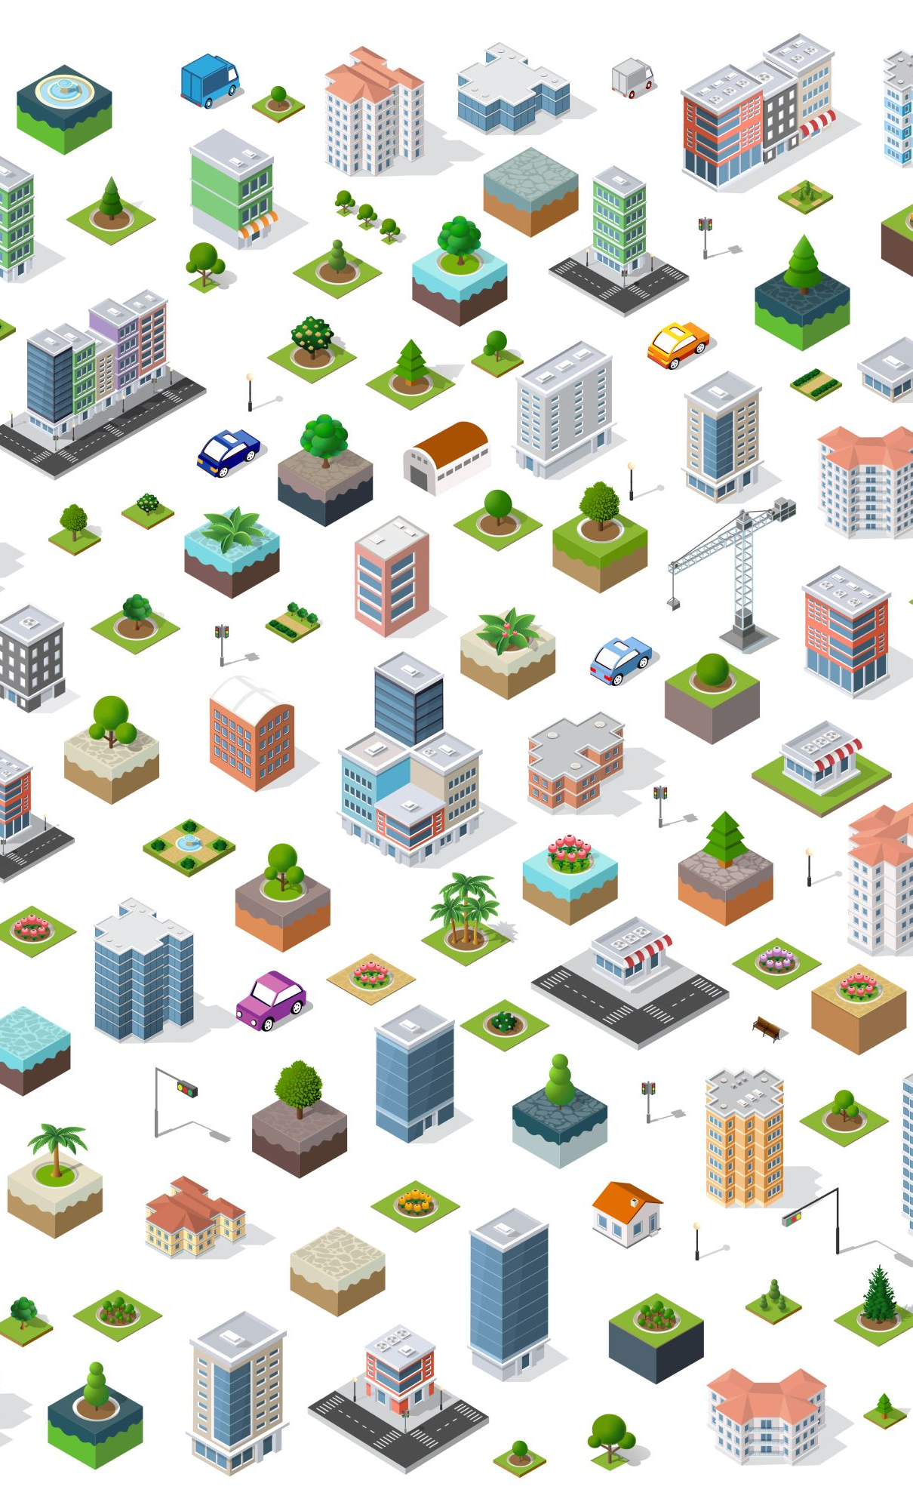
The Emergence of Civilization
Civilization: complex culture in which large numbers of human beings share a number of common elements
8 Characteristics (Last 2 have been added since last list)
Cities
Governments
Religion
Social Structure
Writing
Art and Architecture
Job Specialization
Public Works and Infrastructure

Slide 4
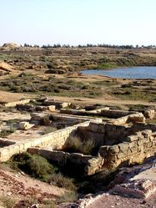
CITIES
The first civilizations developed in river valleys (flat area between hills or mountains) where people could carry on the large-scale farming that was needed to feed a large population.
As food became abundant (easier to get), more people would live in the city.
New patterns of living soon emerged.

Slide 5
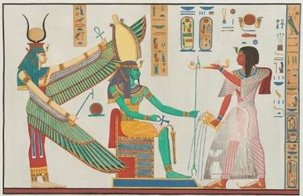
GOVERNMENT
Growing numbers of people, the need to maintain the food supply, and the need for defense (protection) soon led to the growth of governments.
Governments organize and regulate human activity. They also provide for smooth interaction between individuals and groups.
In the first civilizations, governments usually were led by monarchs - kings or queens who rule a kingdom - who organized armies to protect their populations and made laws to regulate their subjects' (citizens') lives.

Slide 6
RELIGION
Important religious developments also characterized the new urban (city) civilizations.
All of them developed religions to explain the forces of nature and their roles in the world.
They believed that gods and goddesses were important to the community's success. To win their favor, priests (religious leaders) supervised rituals (traditions) aimed at pleasing them.
This gave the priests special power and made them very important people.
Rulers also claimed that their power was based on divine approval, and some rulers claimed to be divine (godly).

Slide 7
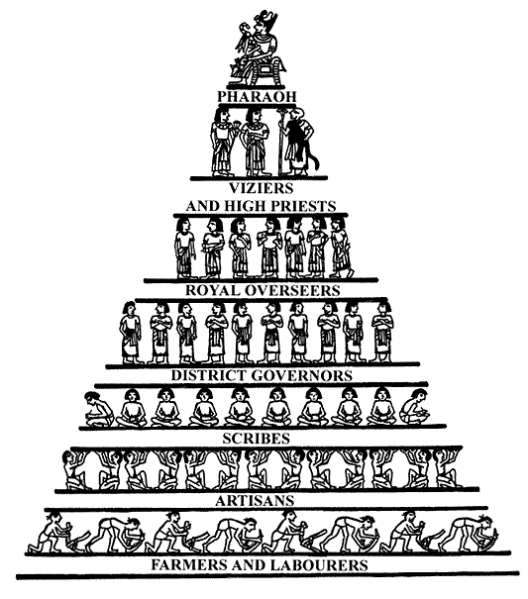
SOCIAL STRUCTURE
A new social structure based on economic (money) power also arose. Rulers and an upper class of priests, government officials, and warriors dominated society.
Below this class was a large group of free people - farmers, artisans (people with special skills), and craftspeople. At the bottom was a slave class. The demand of the upper class for luxury (fancy, expensive) items, such as jewelry and pottery, encouraged artisans and craftspeople to create new products.
As urban populations exported finished goods to neighboring populations in exchange for raw materials, organized trade began to grow.

Slide 8
SOCIAL STRUCTURE CONTINUED…
Because trade brought new civilizations into contact with one another, it often led to the transfer of new technology, such as metals for tools and new farming techniques, from one region to another.
By and large, however, the early river valley civilizations developed independently.
Each one was based on developments connected to the agricultural (farming) revolution of the Neolithic Age and the cities that this revolution helped to produce.
Taken together, the civilizations of Mesopotamia, Egypt, India, and China constituted nothing less than a revolutionary stage in the growth of human society.

Slide 9
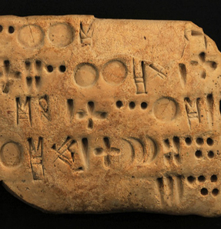
COMMUNICATION/WRITING
Writing was an important feature in the life of these new civilizations.
Above all, rulers, priests, merchants (businessmen), and artisans used writing to keep accurate records.
Of course, not all civilizations depended on writing to keep records. The Inca in Peru (South American country), for example, relied on well-trained memory experts to keep track of their important matters. Eventually, the earliest civilizations used writing for creative expression as well as for record keeping.
This produced the world's first works of literature.

Slide 10
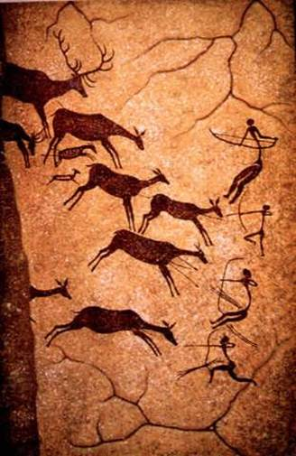
ART and ARCHITECTURE
Significant artistic activity was another feature of the new civilizations.
Architects built temples and pyramids as places for worship or sacrifice, or for the burial of kings and other important people.
Painters and sculptors portrayed (showed) stories of nature. They also provided depictions (drawings) of the rulers and gods they worshiped.

Slide 11
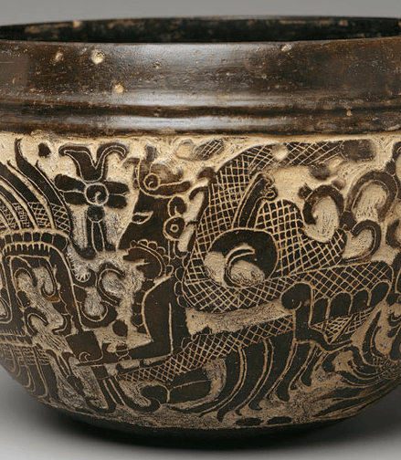
Job Specialization
Civilizations are marked by complex divisions of labor. This means that different people perform specialized tasks.
In a purely agricultural society, members of the community are largely self-sufficient, and can provide food, shelter, and clothing for themselves.
In a complex civilization, farmers may cultivate one type of crop and depend on other people for other foods, clothing, shelter, and information. Civilizations that depend on trade are specially marked by divisions of labor.
Brick layers
Artisans
Stone workers
Soldiers
Metal Workers
Entertainers

Slide 12
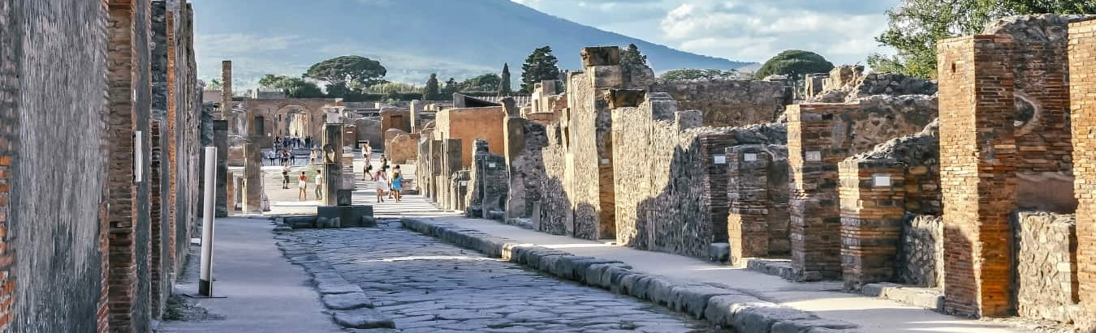
PUBLIC WORKS AND INFRASTRUCTURE
Government organized projects for the common good- assisted in protection of the people and the food supply
Irrigation
Roads
Bridges
Defensive walls

