Slide 1
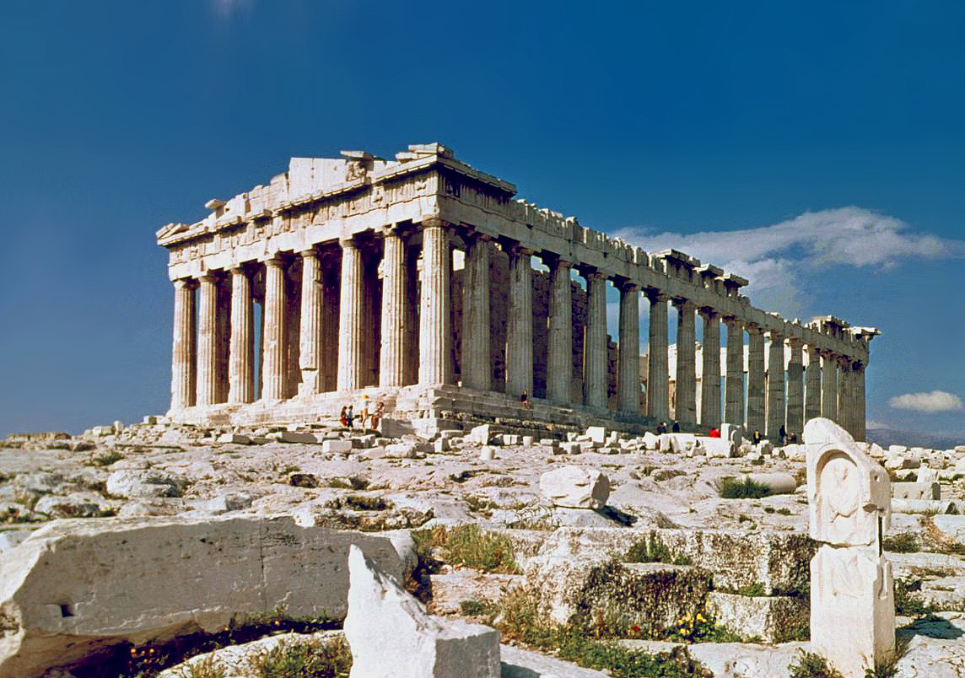
LIFE IN ANCIENT GREECE

Slide 2
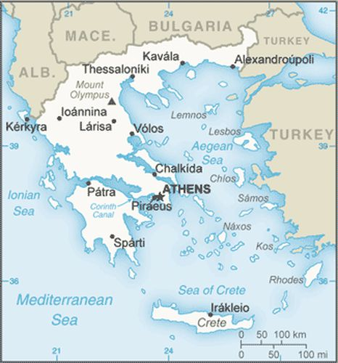
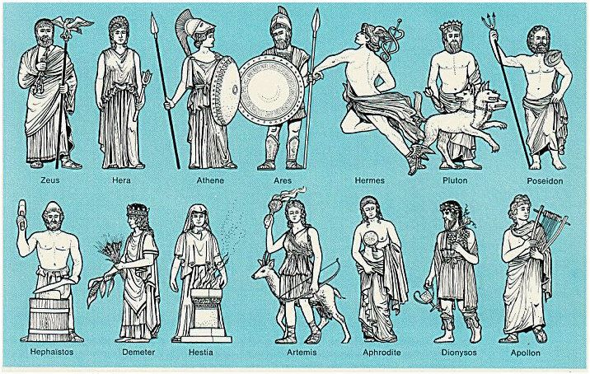
Greece
Ancient or Archaic Greece – time period before Classics from 800 BCE to 500 BCE
This is the age that the City-States Greece is known for rises (polis) – important feature of Greek political life for hundreds of years
Before this time period Greece was small farming villages that slowly evolved in towns and cities with marketplaces, walls, and eventually government (taxes, laws, and armies)
Each city-state was protected by a particular God or Goddess that was treated with reverence, respect, and sacrifice.

Slide 3
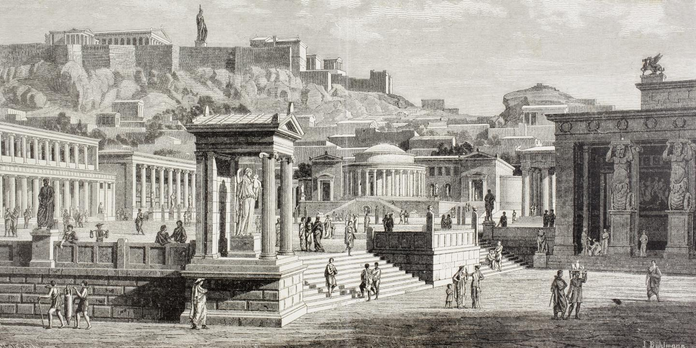
Citizens of Ancient Greece had common speech, temples, religious rites, and customs, but every City-State was different.
All economies of City-States were based on trade and as such land was the most valuable resource
Power was held by hereditary Kings and aristocrats – that held power over the poor and monopolized the best farmland (some even said they were the children of Gods)
There was conflict between nobles and the poor often, because the nobles held all the power.

Slide 4
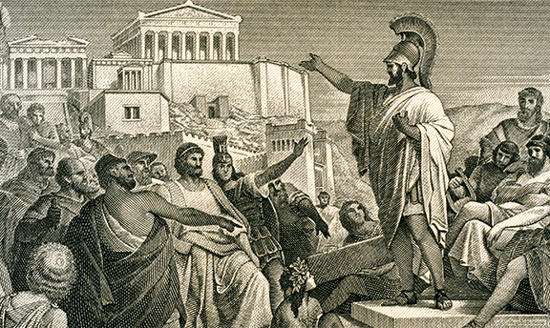
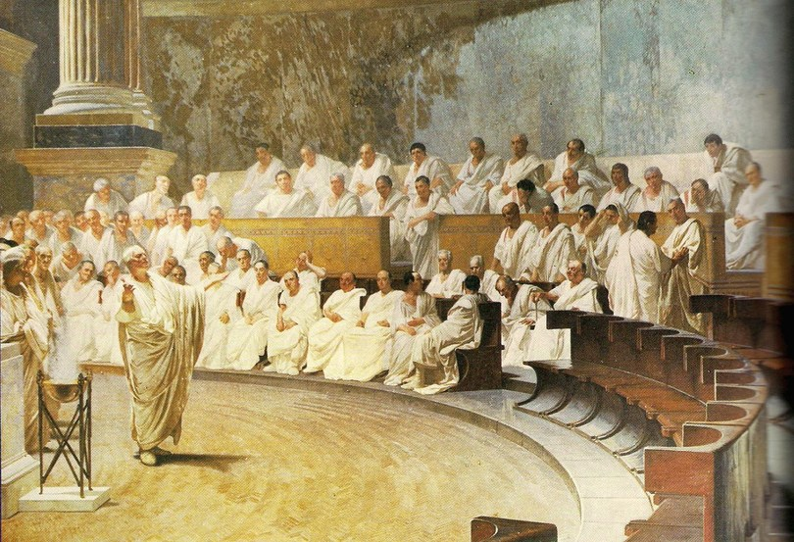
Emigration helped to relieve some of the tension between nobles and the poor, because people would leave their home poleis and into more sparsely populated areas around Greece and the Aegean – colonies from Mediterranean to Asia Minor, and from North Africa to the Black Sea. (caused the rise of many more city-states that were independent)
With the rise of City-States consumer goods were starting to be created – leading to more wealth, more specialization, and more trade.
This lead to governments being overthrown by these new wealthy traders that previously didn’t have power = tyrants! Eventually lead to Demokratia – “rule by the people”

Slide 5
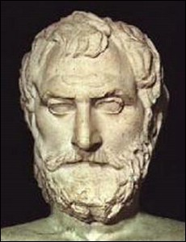
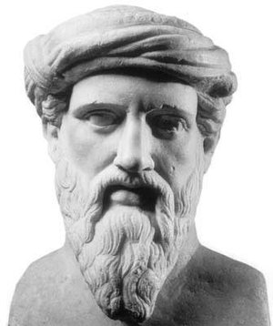
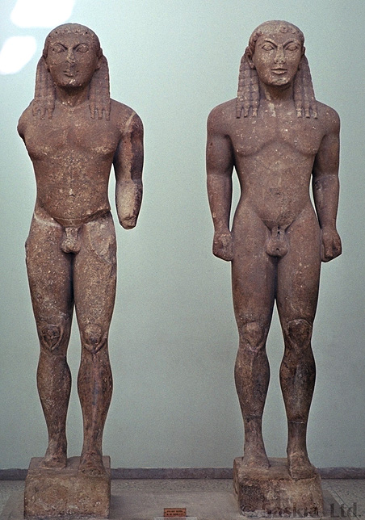
Archaic Renaissance
With emigration Greek styles spread far and wide.
The Epic poet Homer produced the Iliad and Odyssey during this period
Sculptors created the kouroi and the korai – human figurines that served as memorials to the dead.
Science made some leaps and bounds:
Anaximandros devised a theory of gravity
Xenophanes wrote about his discovery of fossils
Pythagoras discovered his famous theorem
This is all leading up to the monumental changes the next few centuries will be bringing

Slide 6
The Eight Ages of Greece - A Complete History (youtube.com)

Slide 7
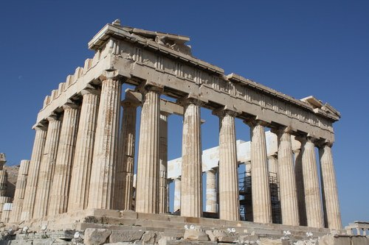
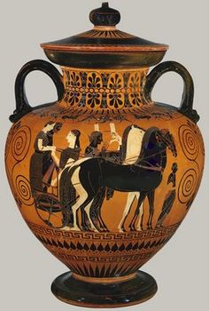
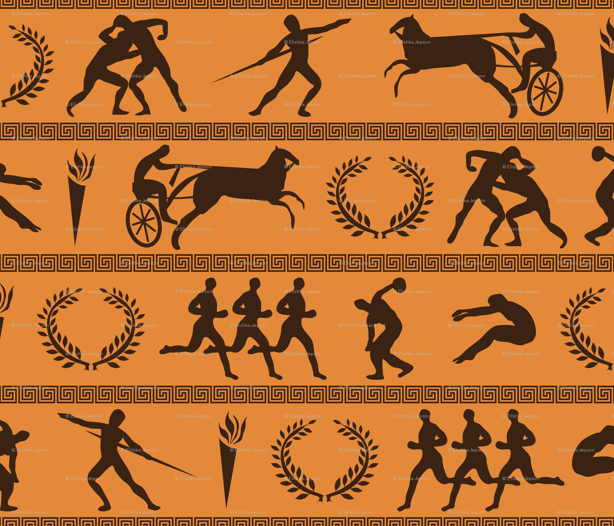
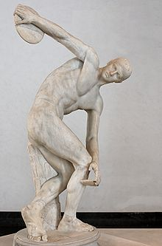
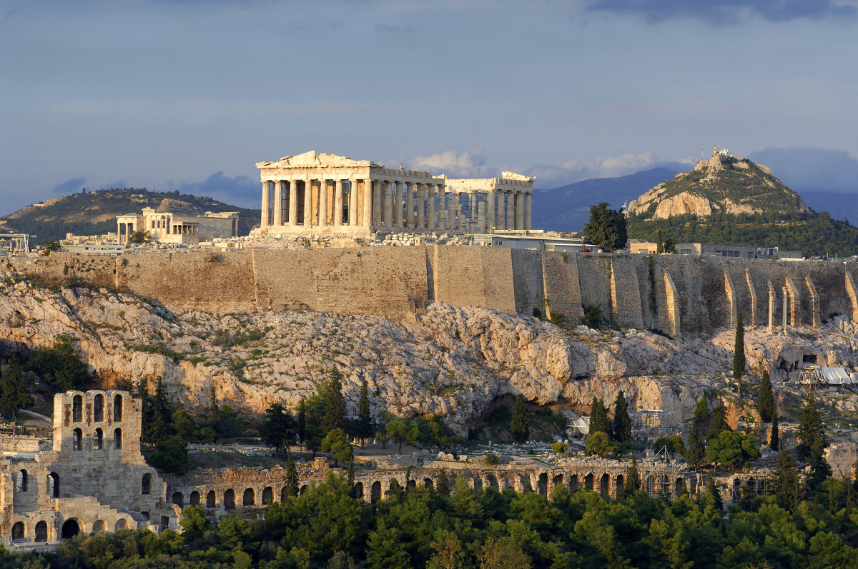
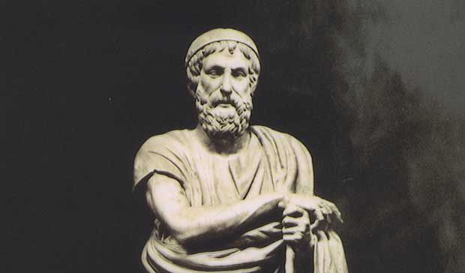
Greek Parthenon – Built to Honour Athena

