Slide 1
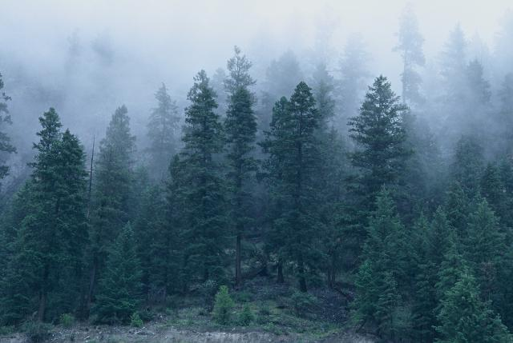
The Regions of BC and their Resources

Slide 2
Regions and Their Implications
The latitude, physical geography, climate, and altitude all affect the types of animal and plant resources found in a specific area.
These factors also determine how people harvest and use these resources.
The relationship the group had with the natural world effected how the people lived and organized their societies.
BC can be divided into four broad geographical regions: the coast, the southern interior, the northeast, and the northern interior.

Slide 3
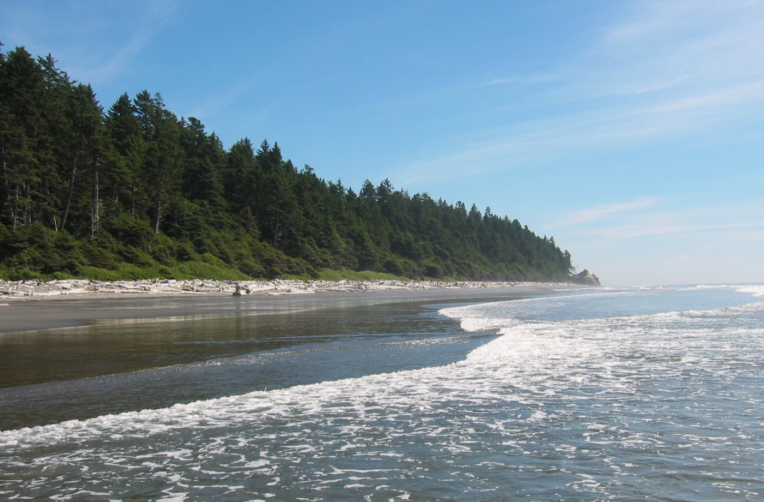
The Coast in Depth
Consists of a wet, mild climate influenced by the pacific ocean.
temp stays above freezing in the winter and below 20 celcius in the summer.
Annual rainfall can be more than 400 cm a year resulting in heavy cloud, and fog covering the mountains.
Climate is ideal for the temperate rainforest that covers the mountains of the area and provides wonderful vegetation with many coniferous trees.
First Nations of the area cherish greatly the western red cedar which grows in the area and is a very useful material used for building homes, in medicines, for art, and in weaving.

Slide 4
Coast Continued..
In much of the coastal regions, mountains seem to rise out of the ocean-creating waterways that form a maze of channels, bays, and inlets.
The coastal region also has hundreds of islands from small to large like Vancouver Island, which protect the mainland from ocean winds.
Thousands of streams and rivers flow down the mountains to combine with the ocean or with the major rivers of the region.
THE SOUTHERN COAST: This region surrounds Georgia Strait and has a different climate and thus a unique environment.
This area lays in the rain shadow of Vancouver Island, including southeast Vancouver Island, the Gulf Islands, and the Fraser Valley.
This area is flatter and has a drier climate which results in differing vegetation.

Slide 5
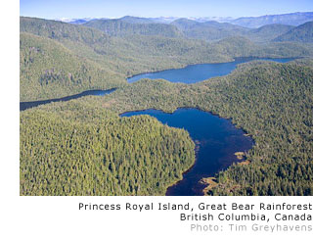
The People of the Coast
The coast has the greatest number of distinct First Nations groups in Canada. 9 groups exist along the northern and central coasts and on the west coast of Vancouver Island.
The Haida, Tsimshian, Nisga’a, Haisla, Xai-Xais (Hai-Hais), Heiltsuk, Kwakwa-ka’wakw, Nuxalk (Nu- Hulk), and Nuu-chah-nulth.
17 other First Nations live along the Georgia Strait, on Vancouver Islands east coast and the opposite mainland, including the Fraser Valley. All are members of the Coast Salish language group.

Slide 6
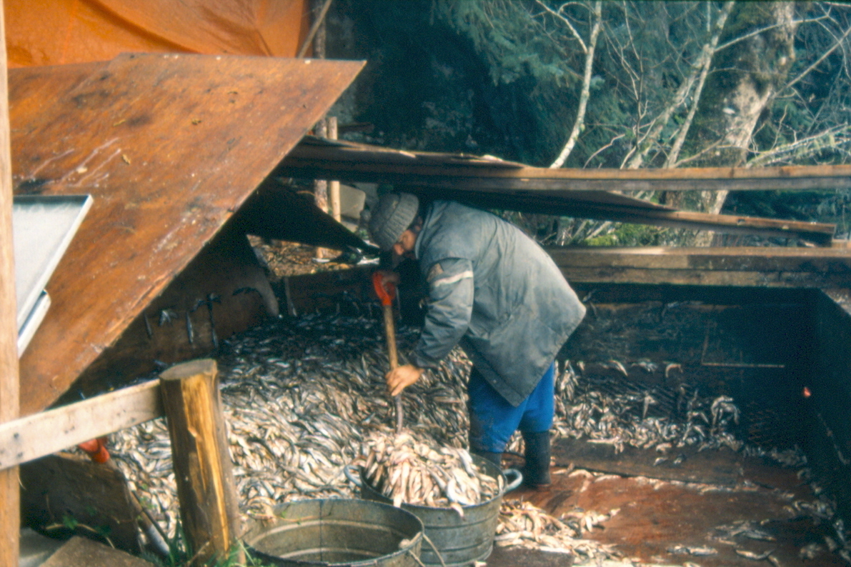
How the Coast Affected Living
The abundant resources on the coast and the mild climate resulted in highly structured societies as people had time away from resource gathering to develop complex social and artistic customs.
Coastal FN adapted to the ocean front environment by forming resource use units, generally composed of extended families also known as house groups.
Resource-use units had a number of territories that provided resources throughout the year, including salmon fishing grounds, hunting territories, and berry harvesting grounds.
Some groups also had oolichan camps which were usually shared by a number of families.

Slide 7
Seasonal Patterns for Survival
Each group had a hereditary chief who was responsible for his people and the appropriate use of resources and territories.
The FN on the coast followed seasonal patterns which allowed them to move from location to location as resources became available.
Winters were spent in large villages of as many as 30 cedar longhouses facing the ocean where feasts, potlatches and winter ceremonies would take place for most of the time there.
In spring people moved to spring resource camps in large groups, some of which would process at oolichan, halibut, seaweed, or seal camps.
In June, the salmon would return so people would spraed out to their salmon camps which were at the mouths of rivers or sometimes on a lake. People would remain here until fall where there would gradually move back to their winter camps.

Slide 8
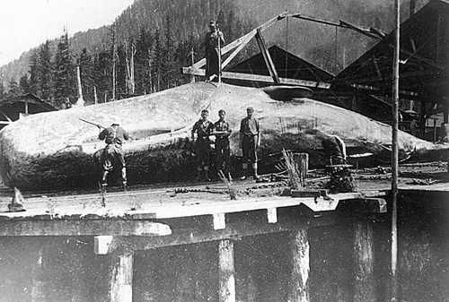
Variations in Seasonal Patterns and Territorial Exchange
This outline varied due to the resources the group had in its territory- for example the Nuu-chah-nulth living along the west coast of Vancouver Island centered around the hunting of whale. This caused different spiritual, ceremonial, and cultural round practices.
The ownership of each territory was inherited by the extended family group that formed the resource-use unit.
Transferring the inherited territorial rights was the principle use of the potlatch-this important ceremony would combine dances, songs, crest, masks, and allot of food and gifts, representing the connection the people had to their land.

