Slide 1
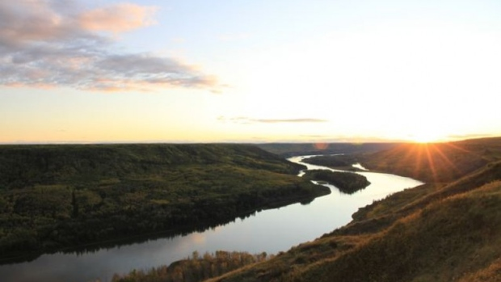
The northeast: people and place

Slide 3
topography
The Northeast region of BC stretches along the Peace River and is separated from the rest of the province by the Rocky Mountains.
This area has more in common with the Northwest Territories to the north, however, it is a unique part of B.C that is comprised of 3 different landscapes: the foothills of the Rockies, the muskeg of the north, and the prairies of the east.
The Northeast region of BC covers two different ecosystems; the Boreal Plains and the Boreal Taiga.

Slide 4
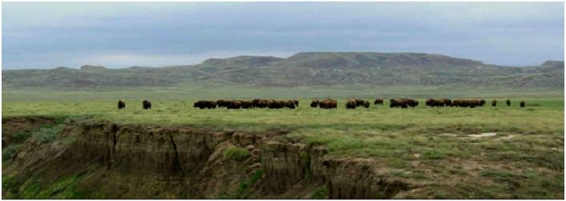
Boreal plains
The Boreal Plains is located on the western tip of the region and is made up of plateaus, plains, and lowlands that go eastward across northern Alberta, Saskatchewan, and Manitoba, and the southern Northwest Territories.
It is flat except in areas where the rivers have cut the earth forming steep sided banks.
Has a wide seasonal temp range with summer highs up to 20 C and winter lows around -20 C
Lowest recorded lows are around -50 C.
The lowlands of the Boreal Plains in the Peace River watershed has a milder climate than the rest of the region with less snowfall.

Slide 5
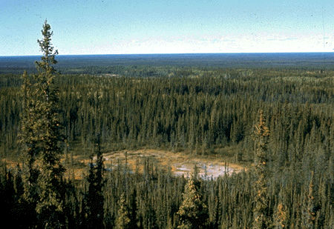
BOREAL Taiga
Boreal Taiga lies north of the Boreal Plains and is made up of muskeg lowlands.
These lowlands are drained by the Liard River watershed which joins the Mackenzie River in the NW Territories.
Here the temperatures are severe due to the cold arctic air causing long frigid winters.
Summers can get as high as 36 C but are mostly effected by unstable weather with heavy cloud cover.

Slide 6
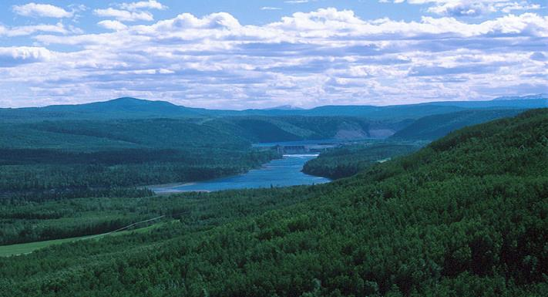
Rivers
The rivers that begin on the Rocky Mountains carve their way through the prairie land.
Three major tributaries break through the rocky mountains. They are the Peace River, the Omineca, Finlay, and Parsnip Rivers.
The Pine River moves more south through the mountains and has been an age old transportation route for the First Nations people of the area called the Pine Pass.

Slide 7
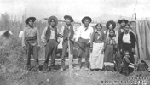
People of the northeast
The people of the Northeast region belong to the Athapaskan language family which is spoken from Alaska to the southwest United States.
Three Athapaskan language groups lived in the northeast region:
Farthest north was the southern limit of the E’cho Dene or Slavey peoples territory which included parts of the Yukon, NW Territories, and northern Alberta.
The Dunne’za (previously known as the Beaver) inhabited the foothills and forests between the Liard and the Peace Rivers.
In the mountains in the south were the Sekani peoples.

Slide 8
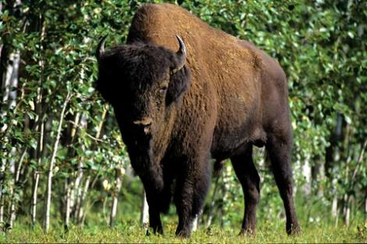
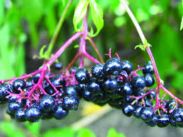
Resource Use
The peoples of the Northeast led highly mobile lives with the moose being their principal resource.
The Dunne-za also hunted or snared rabbits, beaver, bear, muskrats, and marmots for food and furs.
Other large mammals found in the region were an extremely important resource: elk, caribou, deer, and wood buffalo.
Birds like grouse, ducks, and geese added to the diet as did fish.
People also ate a wide variety of berries such as choke berries, huckleberries, Saskatoon berries, and some choice roots.

