Slide 1
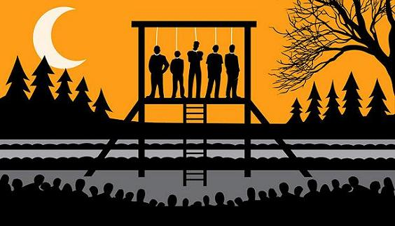
James Douglas and the Lead up to the Chilcotin War

Slide 2
James Douglas: First Governor
Was chief factor of the HBC in B.C and as colonial governor from 1851-1864
The Colony at Victoria (1849) was created without negotiation with, or thought for, First Nations
The colony of B.C and Vancouver would be joined in 1866 under the name British Columbia.
Victoria was the capital.
Fort Victoria
Fort Vancouver

Slide 3
An Important Judge: Chief Justice Baillie Begbie
Was the chief agent of the justice system in the colonial era.
He played an important role in administering colonial policy and passing down judgments on settlers and Aboriginal peoples.
WHY IS THIS PROBLEMATIC?

Slide 4
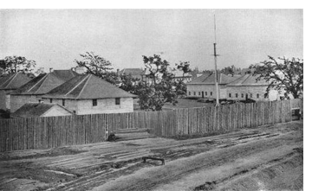
Good Intentions to Start
Settlement at Fort Victoria
When Douglas began as governor, he had clear instruction to follow Britain’s colonial policy and the Royal Proclamation.
He was to negotiate treaties to purchase land for settlement.
At first Douglas adhered to these policies and negotiated what are known as the DOUGLAS TREATIES

Slide 5
The Douglas Treaties – 1850-54
These will be the only treaties negotiated in British Columbia until the Nisga’a Treaty of 1998.
14 treaties on Vancouver Island around Victoria, Saanich, Sooke, Nanaimo, and Port Hardy
Surrender the land, “entirely and forever,” in exchange for:
Cash, clothing, or blankets
Chiefs and descendants kept existing village sites and fields for their use
The liberty to hunt over unoccupied lands, and the right to carry on ‘fishing as formerly.’

Slide 6
A Change of Heart
Douglas did not negotiate any treaties after the ‘Douglas Treaties.’
Earl Grey, the colonial secretary until 1852, believed it was important to protect Aboriginal rights in the colonies.
Policy in London changed and a new colonial secretary, Sir Edward Lytton, wanted to create communities fashioned after English country villages, with a church in the center and farms surrounding it.
Douglas agreed with this vision and they switched from TREATIES, to INDIAN RESERVES to help ‘the survival of the Indian people.’

Slide 7
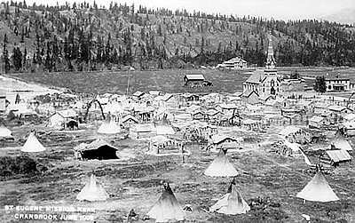
RESERVATIONS
Under the DOUGLAS SYSTEM, First Nations groups would be given parcels of land reserved for them but owned by the CROWN.
Lots of these reserves were created in populated areas, where settlers were moving, and where the soil was fertile for farming. (Fraser Valley, Thomson and Okanogan regions, and Vancouver Island)
First Nations people were encouraged to pre-empt land (meaning: the crown gave 160 acres of free land they could keep as long as they cleared and farmed it) just as the settlers did.
European and American settlers started to complain that the First Nations people, who outnumbered settlers at this time, would would take all the best land.

Slide 8
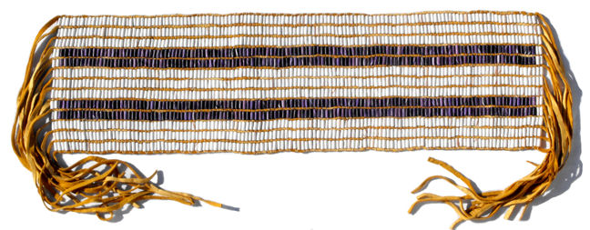
A Bittersweet Legacy
Douglas fought hard to defend land rights of First Nations people against the settlers and he assumed that First Nations people would ASSIMILATE into the British based society→ COLONIALISM
He viewed Aboriginal peoples as having similar rights to British settlers and enacted laws for First Nations peoples to VOTE, and PRE-EMPT land.
HE HOWEVER, IGNORED ABORIGINAL TITLE: A legacy that would lead to his successors believing Aboriginal title didn’t exist.
In a speech made just before he retired, Douglas mentioned giving 10 acres per family to the Aboriginal peoples to form reserves. He tried to clarify this, as he did not mean for this to be used as law, but the damage had been done.

