Slide 1
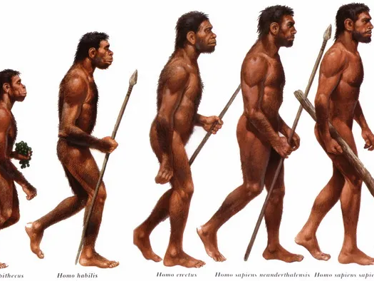
MARCH TO CIVILIZATION: RISE OF Homo sapien sapIENs
The Paleolithic and Neolithic Eras

Slide 2
REVIEW
Early Stages of Development
1st human-like creatures lived in Africa
3-4 Million years ago
Australopithecines
Hominids
Human and other human-like creatures that walk upright
Australopithecines were the first hominids
Able to make simple tools
Homo Erectus
“Upright Human Being”
1.5 Million Years Ago
Larger and more varied tools

Slide 3
Homo sapiens
Homosapiens
“Wise Man”
2 subgroups
Neanderthals
1st found in Neander Valley Germany
100,000 and 30,000 BC
Found in Europe and Southwest Asia
Relied on Stone Tools
First people to bury
Homo Sapiens Sapiens
Both developed from homo sapiens
Homo Sapiens Sapiens
Appeared in Africa 150,000 and 200,000 years ago
30,000 Homo Sapiens Sapiens replaced Neanderthals
Why?

Slide 4
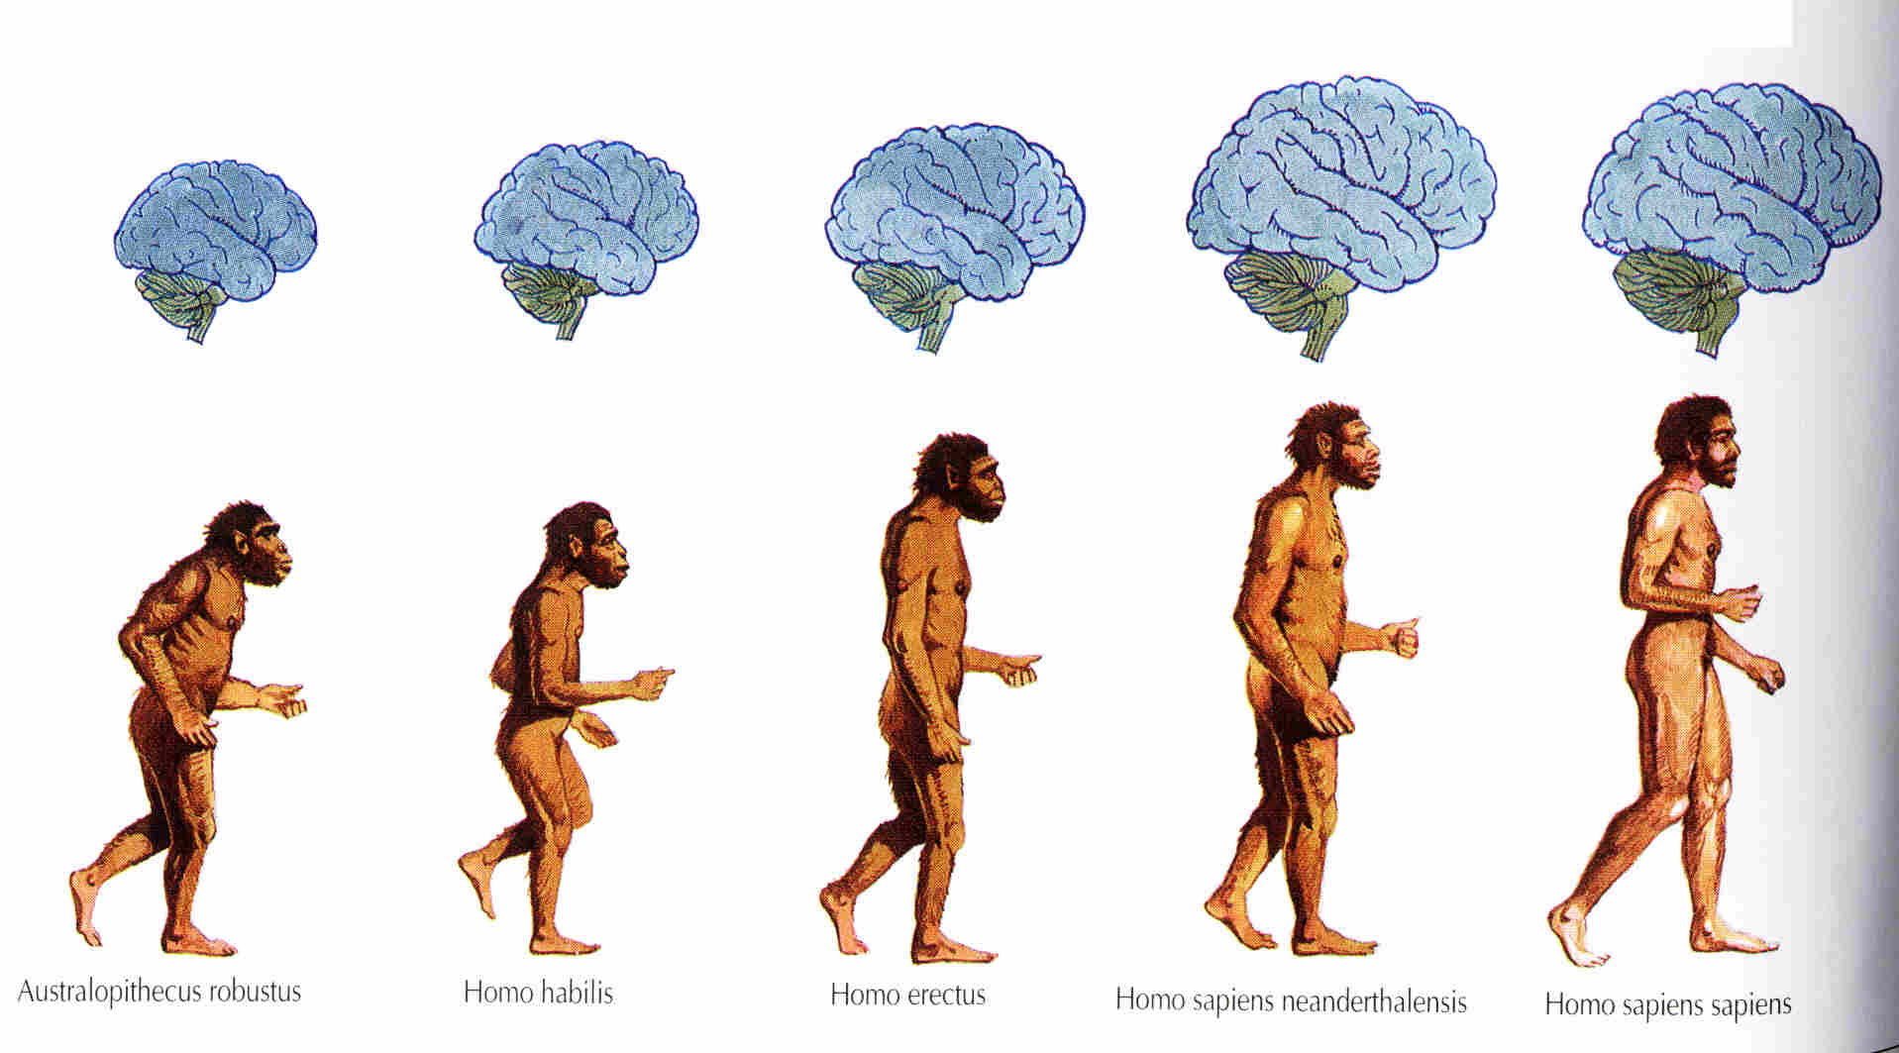

Slide 5
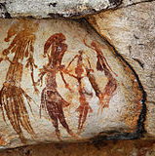
The Hunter-Gatherers of the Old Stone Age
Paleothic Age
2,500,000 to 10,000 BC
Used simple stone tools
Sometimes called Old Stone Age
Small communities, fishing, hunting, gathering
Learned how to make sophisticated tools
How to use fires, adapt and change with physical environment
Nomads
People who move place to place
Hunted animals and gathered wild plants for survival
Cave paintings

Slide 6
The Neolithic revolution
Neolithic Revolutions
Revolution occurred in the Neolithic Age (8,000 to 4,000 BC)
New Stone Age
What changed?
Switched from hunting and gathering to raising and keeping animals
Systematic Agriculture- growing food on a regular basis
Domestication of animals added a steady source of meat, milk, and wool
Agriculture revolution
What does this term mean?

Slide 7
The Emergence of Civilization
Civilization: complex culture in which large numbers of human beings share a number of common elements
6 Characteristics
Cities
Governments
Religion
Social Structure
Writing
Art
Describe the relationship between an increase in good production and the rise of cities and governments

Slide 8
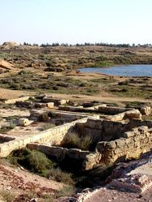
CITIES
The first civilizations developed in river valleys (flat area between hills or mountains) where people could carry on the large-scale farming that was needed to feed a large population. As food became abundant (easier to get), more people would live in the city. New patterns of living soon emerged.

Slide 9
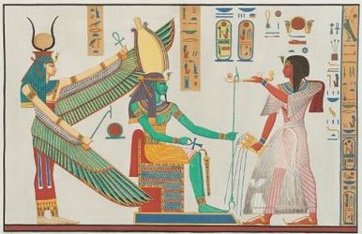
GOVERNMENT
Growing numbers of people, the need to maintain the food supply, and the need for defense (protection) soon led to the growth of governments. Governments organize and regulate human activity. They also provide for smooth interaction between individuals and groups. In the first civilizations, governments usually were led by monarchs - kings or queens who rule a kingdom - who organized armies to protect their populations and made laws to regulate their subjects' (citizens') lives.

Slide 10
RELIGION
Important religious developments also characterized the new urban (city) civilizations. All of them developed religions to explain the forces of nature and their roles in the world. They believed that gods and goddesses were important to the community's success. To win their favor, priests (religious leaders) supervised rituals (traditions) aimed at pleasing them. This gave the priests special power and made them very important people. Rulers also claimed that their power was based on divine approval, and some rulers claimed to be divine (godly).

Slide 11
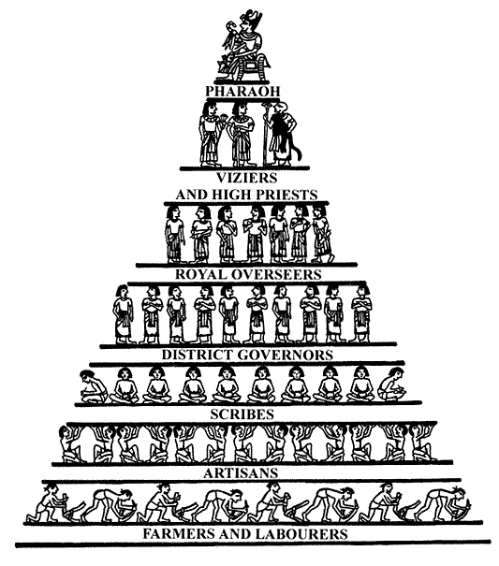
SOCIAL STRUCTURE
A new social structure based on economic (money) power also arose. Rulers and an upper class of priests, government officials, and warriors dominated society.
Below this class was a large group of free people - farmers, artisans (people with special skills), and craftspeople. At the bottom was a slave class. The demand of the upper class for luxury (fancy, expensive) items, such as jewelry and pottery, encouraged artisans and craftspeople to create new products.
As urban populations exported finished goods to neighboring populations in exchange for raw materials, organized trade began to grow.

Slide 12
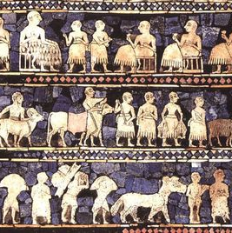
SOCIAL STRUCTURE CONTINUED…
Because trade brought new civilizations into contact with one another, it often led to the transfer of new technology, such as metals for tools and new farming techniques, from one region to another. By and large, however, the early river valley civilizations developed independently. Each one was based on developments connected to the agricultural (farming) revolution of the Neolithic Age and the cities that this revolution helped to produce. Taken together, the civilizations of Mesopotamia, Egypt, India, and China constituted nothing less than a revolutionary stage in the growth of human society.

Slide 13
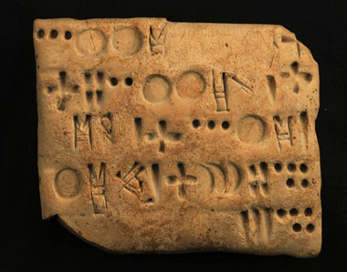
WRITING
Writing was an important feature in the life of these new civilizations.
Above all, rulers, priests, merchants (businessmen), and artisans used writing to keep accurate records.
Of course, not all civilizations depended on writing to keep records. The Inca in Peru (South American country), for example, relied on well-trained memory experts to keep track of their important matters. Eventually, the earliest civilizations used writing for creative expression as well as for record keeping.
This produced the world's first works of literature.

Slide 14
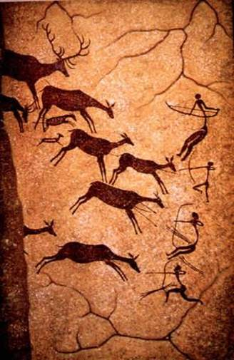
ART
Significant artistic activity was another feature of the new civilizations.
Architects built temples and pyramids as places for worship or sacrifice, or for the burial of kings and other important people.
Painters and sculptors portrayed (showed) stories of nature. They also provided depictions (drawings) of the rulers and gods they worshiped.

