Slide 1
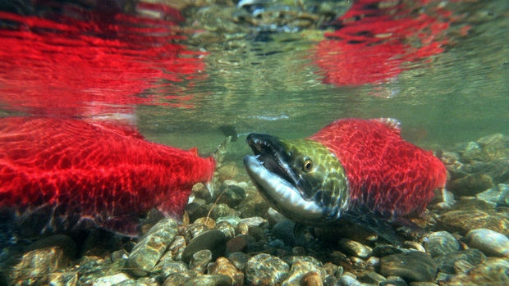
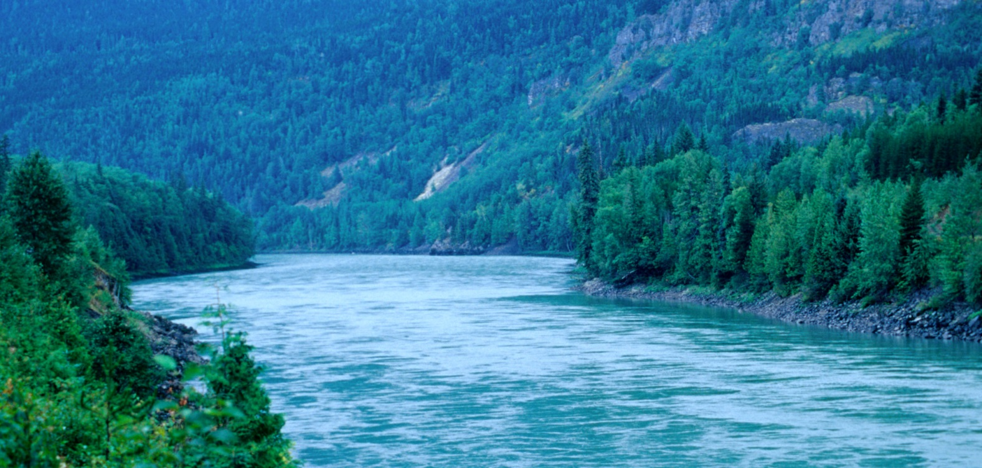
The Northern Interior:
People and Place

Slide 2
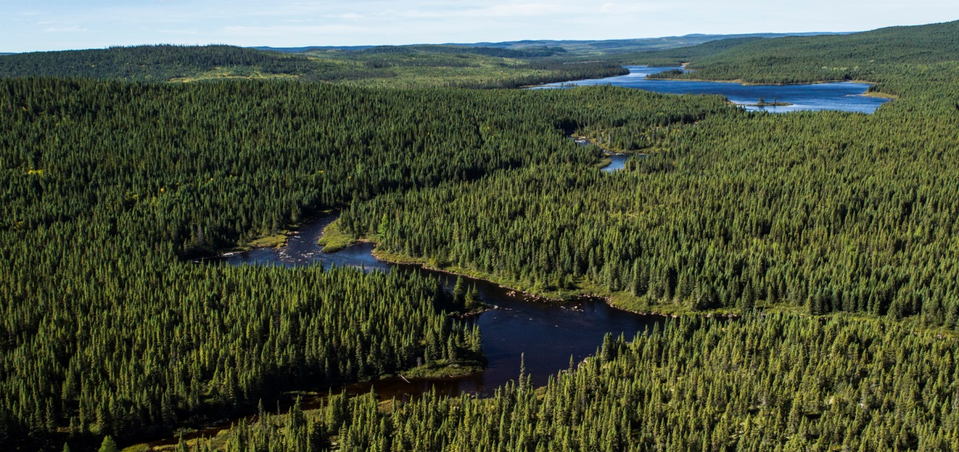
Topography
The Northern Interior covers a large part of BC and extends into Yukon territory.
The topography is similar to that of northern Canada and the Northern Interior is part of the Great Boreal Forest which stretches across the continent as far as Newfoundland.
Spruce and fir dominate where the climate is cold and precipitation is low. There is a less diverse plant life in this region due to harsh climate.
Fewer people live in this region than in the rest of BC.

Slide 3
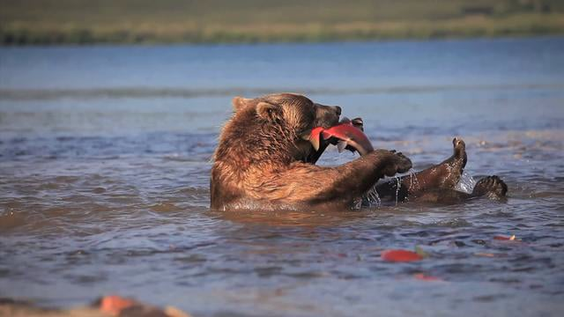
The land is made up of mountains and plateaus, with many lakes interspersed.
Water evaporation levels are low and the climate is cold, thus the ground stays cold, moist and poorly drained. This leads to a large expanse of muskeg or peat bogs.
The central area of this region, east of the Coast Mountains, is the Chilcotin and Cariboo Plateaus which stretch to the Nechako Plateau.
This area has cold winters and warm summers as it lies in a rain shadow of the coast mountains.
Two major river systems exist in this region: the Fraser and the Skeena Rivers; which provide abundant pacific salmon.

Slide 4
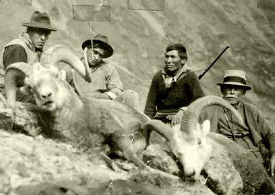
People of the Northern Interior
Most of the First Nations in the northern interior belong to the very large Athapaskan language family. In the Yukon alone, 7 languages from this family are spoken: Gwich’in, Han, Kaska, Northern Tutchone, Southern Tutchone, Tagish, and Upper Tanana.
Inland Tlingit is spoken in NW BC and southern Yukon and is distantly related to the Athapaskan language family.
Athapaskan speaking people who live in the northern interior are mostly Yinka Dene, which means “the people of the land.”
The Dakelh people live in the central interior and are known in English as the Carrier.
The Tahltan people live in the Stikine watershed while the Gitxsan, on the upper Skeena River, occupy the territory between the northern interior and the coast.
The Wet’suwet’en live in the Southeast of the region and play with the balance between being coastal and a northern interior people.

Slide 5
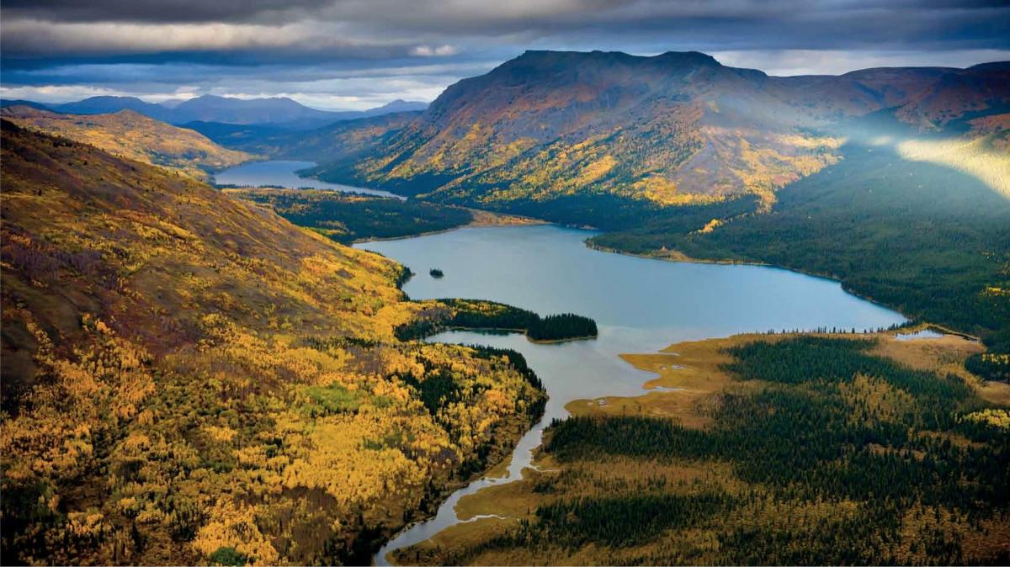
Society
In most of the northern interior, people adapted to the harsh climate and more limited resources by having a very flexible society.
The basic social unit was the extended family which moved about each year according to the season and the availability of food-mostly large game.
Theirs was a mobile society ready to hunt, fish, and trap to gather resources as they moved through the extremely large territory.

